Slide 1
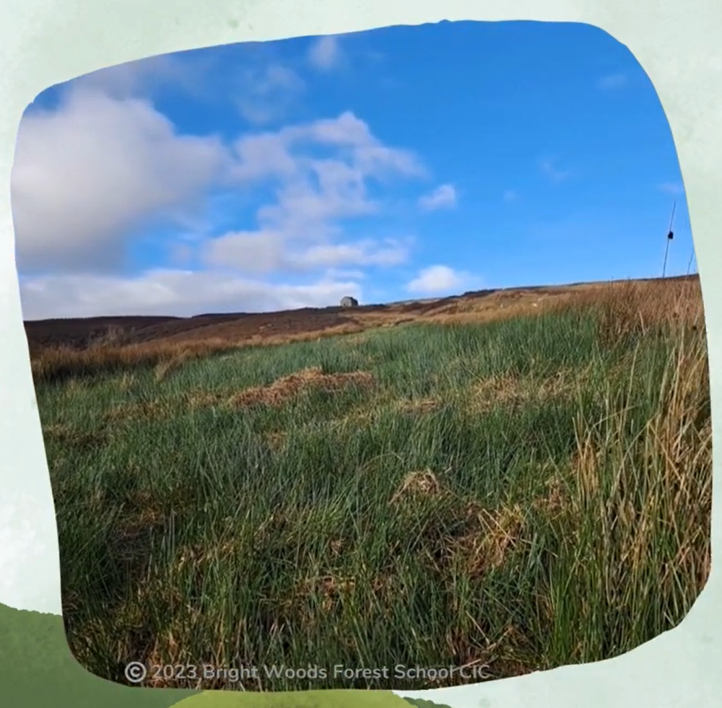
Cuthbert's Moor
An area of upland peatland in the Durham Dales
2023 Bright Woods Forest School CIC

Slide 2
2023 Bright Woods Forest School CIC

Slide 3
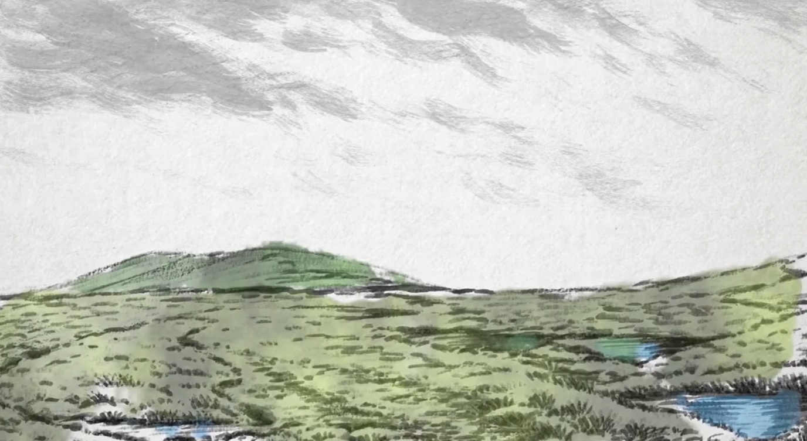
What’s special about peatlands?

Slide 5
What do living things need so they can grow?
Plants
Animals

Slide 6
What plants need to grow
Producers
Air
Sunlight
Water
Habitat

Slide 7
What is a producer?
Producers are organisms that are able to make their own food.
Plants are producers - they use energy from the sun, air and water to make their own food.
This is called photosynthesis.

Slide 8
What animals need to grow
Consumers
Air
Food
Water
Habitat

Slide 9
What is a consumer?
Consumers are living things that can’t make their own food so have to eat other living things to grow.
They get the nutrients and energy they need to survive from eating plants, other animals or both.

Slide 10
Activity - Producers and consumers
In your group, look at the Species Cards and see if you can sort them into Producers and Consumers.
Lapwing
Gets its food from
Caterpillars
Beetles
Worms
Flies
Producers make their own food.
Consumers eat other living things.

Slide 11
Let’s take a closer look at Consumers
Consumers can be divided into three groups depending on what they eat. Do you know what these are?

Slide 12
Herbivores, Carnivores and Omnivores
Herbivore
Omnivore
Carnivore

Slide 13
Activity - Herbivores, carnivores and omnivores
In your group, look at the Consumers and see if you can sort them into Herbivores, Carnivores and Omnivores.
Herbivore
Carnivore
Omnivore
only eats Meat from other animals
eats a mix of Plants and Meat
only eats Plants

Slide 14
What is a food chain?
It shows how energy is passed from plants to animals

Slide 15
Activity - Finding food chains on Cuthbert’s Moor
Pick one of the Producers from your Species Cards then look at the Consumers and what food they eat.
See if you can you make a food chain with 3 cards or more.

Slide 16
Peatlands are an Ecosystem
Living Things
Non-living Things
Animals
Bacteria
Sunlight
Air
Algae
Soil
Rocks
Water
Plants
Fungi

Slide 17
Credits
Lapwing, Curlew and Black Grouse sound recordings by Simon Elliott
‘The Day We Found The Bog’ Video
Thanks to funding provided by

