Slide 1
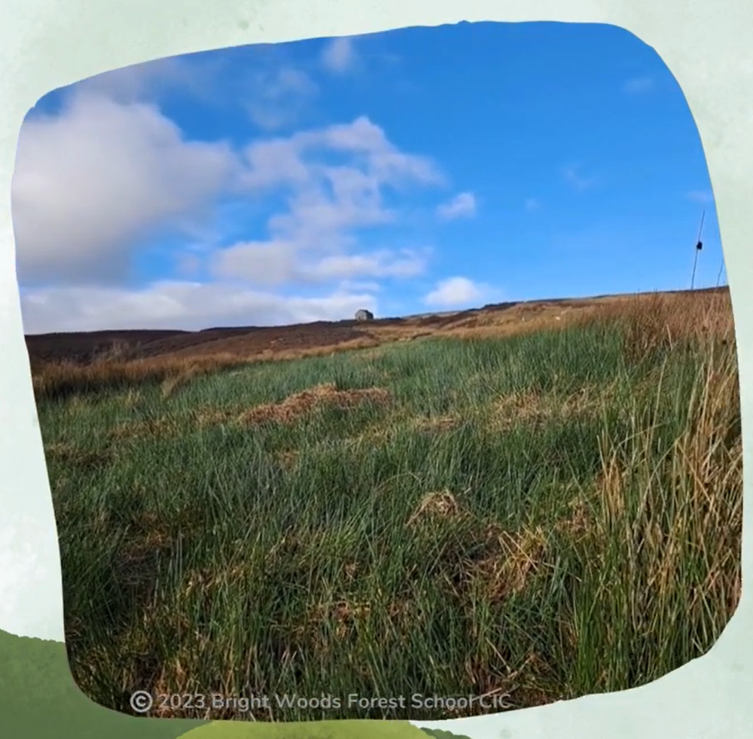
Cuthbert's Moor
An area of upland peatland in the Durham Dales
2023 Bright Woods Forest School CIC

Slide 2
2023 Bright Woods Forest School CIC

Slide 3
What do you already know about peatland?
Where are they?
What do they look, sound or feel like?
You might not know anything!
What might you find there?
Do they do anything important?

Slide 4
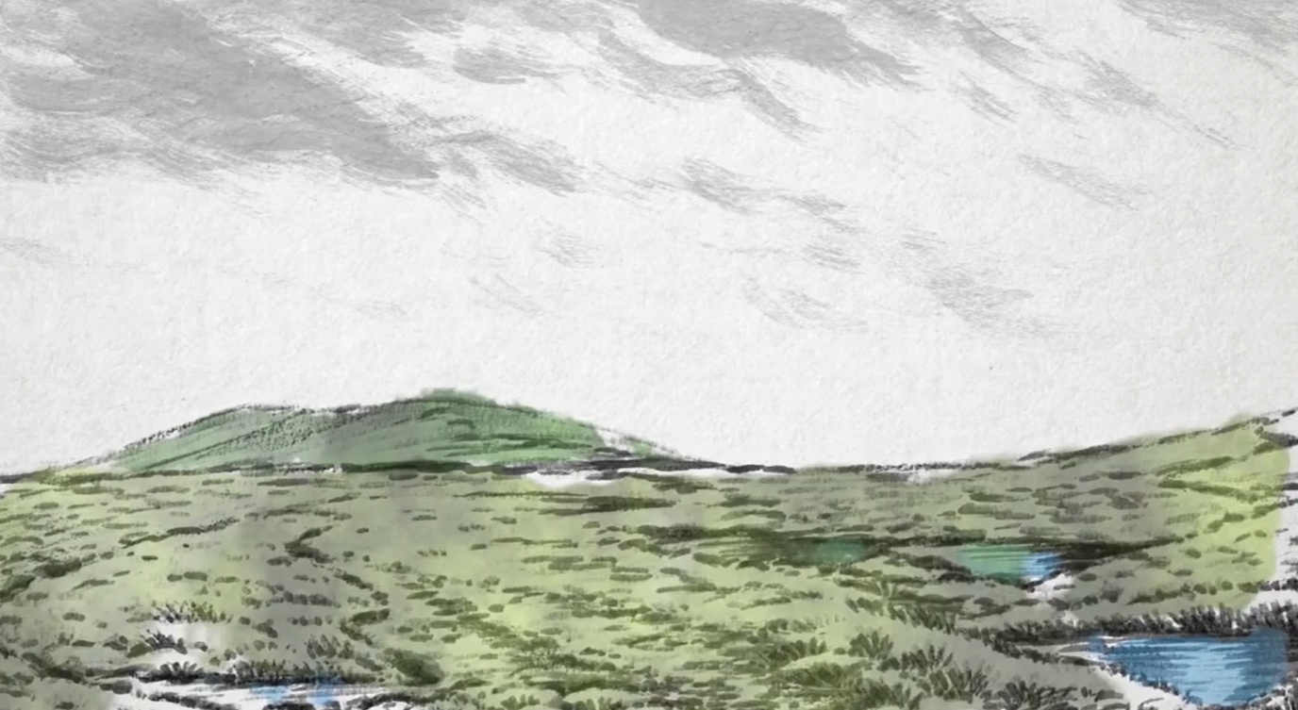
What’s special about peatlands?

Slide 6
What is peatland?
Living Plants
Peat Layer
at least 30cm deep
Rock
Martin-Ortega, J., Glenk, K., & Byg, A. (2017). Online Peatland Learning Module. Peatland Action, Scottish Natural Heritage.
What is peatland?

Slide 7
Top Layer - Living Plants
Sphagnum Moss
Heather
Cotton Grass
Bilberry
Sundew
Growing Conditions
What is peatland?

Slide 8
Middle Layer - Peat Layer
1mm - 1 Year
10cm - 100 Years
2020
2021
2023
2022
1m - 1000 Years
What is peatland?

Slide 9
Base Layer - Rock
10 000 BC
9000 BC
8000 BC
7000 BC
6000 BC
5000 BC
4000 BC
3000 BC
2000 BC
1000 BC
0
1000 AD
2000 AD
What is peatland?

Slide 10
Taking Peat Depths - Process
Fixing the start
Pull out the tape
Push rod down
Measure
Record
Move set distance
Repeat
Keep recording

Slide 11
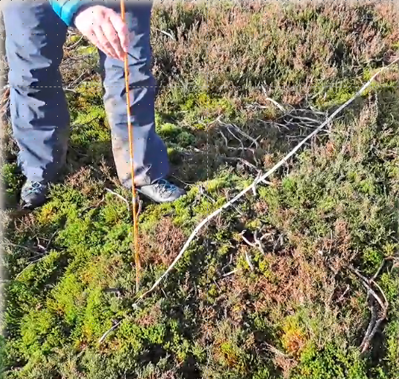
Taking Peat Depths - Results
Can you work out how many years it has taken for this peat to build up?
This measured about 160cm
2023 Bright Woods Forest School CIC

Slide 12
2023 Bright Woods Forest School CIC

Slide 13
Activity - Taking Peat Depths
Create a miniature peatland in a trough.
First add rocks, then soil, then moss.
Take peat depth measurements.
Record your findings.

Slide 14
Recording your results
You can show your results on a Line Graph to make it easier for people to understand.
Line Graph Showing Actual Peat Depths Taken on Cuthbert’s Moor
Distance along transect (metres)
0
1
2
3
4
5
6
7
8
9
10
5
10
Plot the real peat depths from Cuthbert’s Moor on your sheet.
15
20
25
30
Depth of peat (centimetres)
35
40
In this example the depth was 42cm at 0m along the transect and 61cm at 1m, then join the dots.
45
50
55
60
65
70

Slide 15
What do your results show?
Plotting the peat depths then colouring the different layers is like being able to see underground. It gives a picture of what Cuthbert’s Moor looks like below ground level.
Line Graph Showing Actual Peat Depths Taken on Cuthbert’s Moor
Distance along transect (metres)
Living Plants
0
1
2
3
4
5
6
7
8
9
10
11
12
13
14
15
Ground
Level
Ground
Level
Ground
Level
5
10
15
20
25
Peat Layer
30
Depth of peat (centimetres)
35
40
45
50
55
60
65
Rock Layer
70

Slide 16
Where is peatland found?

Slide 17
Where is Cuthbert’s Moor?
Deep Peaty Soils - over 40cm deep
Cuthbert’s Moor
Shallow Peaty Soils - 10 to 40cm deep
Middleton in Teesdale
Mickleton
Eggleston
Soils With Peaty Pockets
Romaldkirk
Cotherstone
Lartington
Barnard Castle
France, A. Online Extent Of Peatlands In England. Catchment Based Approach Data Hub.

Slide 18
Is all peatland the same?
Good Ecological Condition
Martin-Ortega, J., Glenk, K., & Byg, A. (2017). Online Peatland Learning Module. Peatland Action, Scottish Natural Heritage.
Notes:
Takes carbon out of the atmosphere.
Clearer water helps rivers downstream.
Provides a habitat for various plants and wildlife

Slide 19
Intermediate Ecological Condition
Martin-Ortega, J., Glenk, K., & Byg, A. (2017). Online Peatland Learning Module. Peatland Action, Scottish Natural Heritage.
Notes:
Releases some carbon into the atmosphere.
Water not as clear, especially after heavy rain.
Still a habitat for plants and wildlife but not as many

Slide 20
Poor Ecological Condition
Martin-Ortega, J., Glenk, K., & Byg, A. (2017). Online Peatland Learning Module. Peatland Action, Scottish Natural Heritage.
Notes:
Releases much more carbon into the atmosphere.
Water very brown and not good for river quality.
Not a good habitat for many plant or animal species

Slide 21
Peatland as an Ecosystem
Biotic Factors
Abiotic Factors
Animals
Bacteria
Sunlight
Air
Algae
Soil
Rocks
Water
Plants
Fungi
Notes:
Biotic - The living organisms in an ecosystem.
Abiotic - The non-living, physical, and chemical component in an ecosystem

Slide 22
Credits
Lapwing, Curlew and Black Grouse sound recordings by Simon Elliott
‘The Day We Found The Bog’ Video
Peatland Structure and Condition Diagrams - Martin-Ortega, J., Glenk, K., & Byg, A. (2017). Online Peatland Learning Module. Peatland Action, Scottish Natural Heritage.
Catchment Based Approach Data Hub
Location of Cuthbert’s Moor Map - France, A. Online Extent Of Peatlands In England. Catchment Based Approach Data Hub.
Thanks to funding provided by

