Slide 1

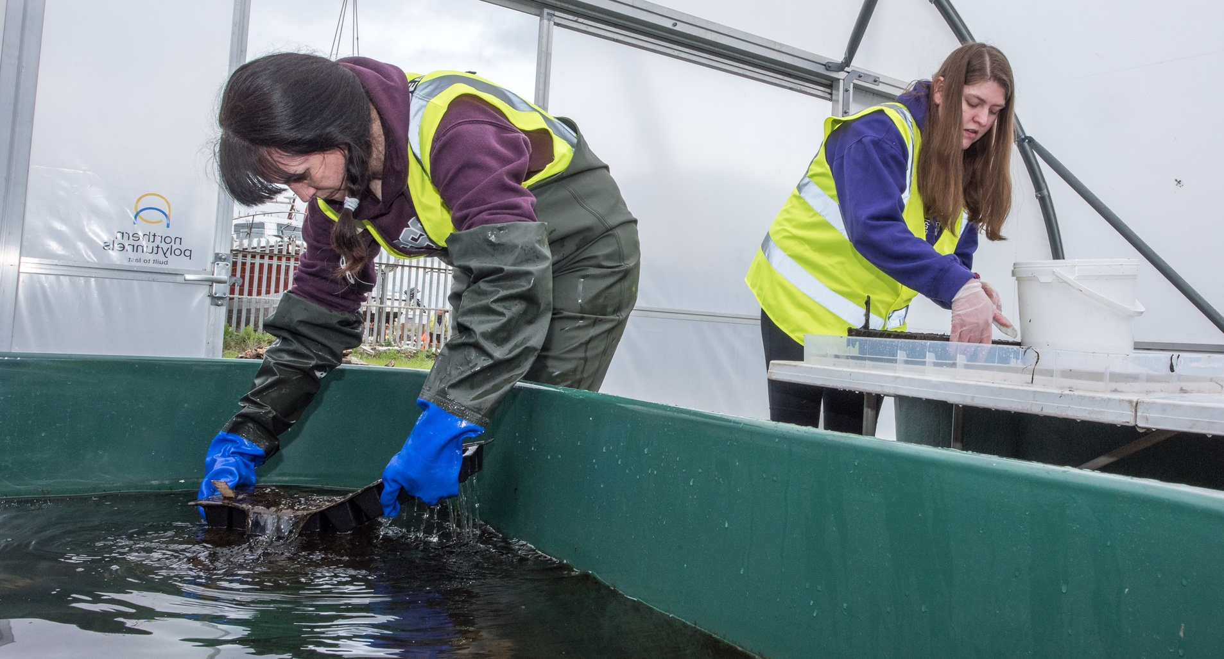

CAREERS IN CONSERVATION
Explore the careers available in conservation!

Slide 2

LEARNING OUTCOMES
By the end of this presentation you will have learned:
  The importance of diversity in conservation work.
  The roles available to you in conservation.
  Skills and attributes that are needed to undertake these roles.

Slide 3
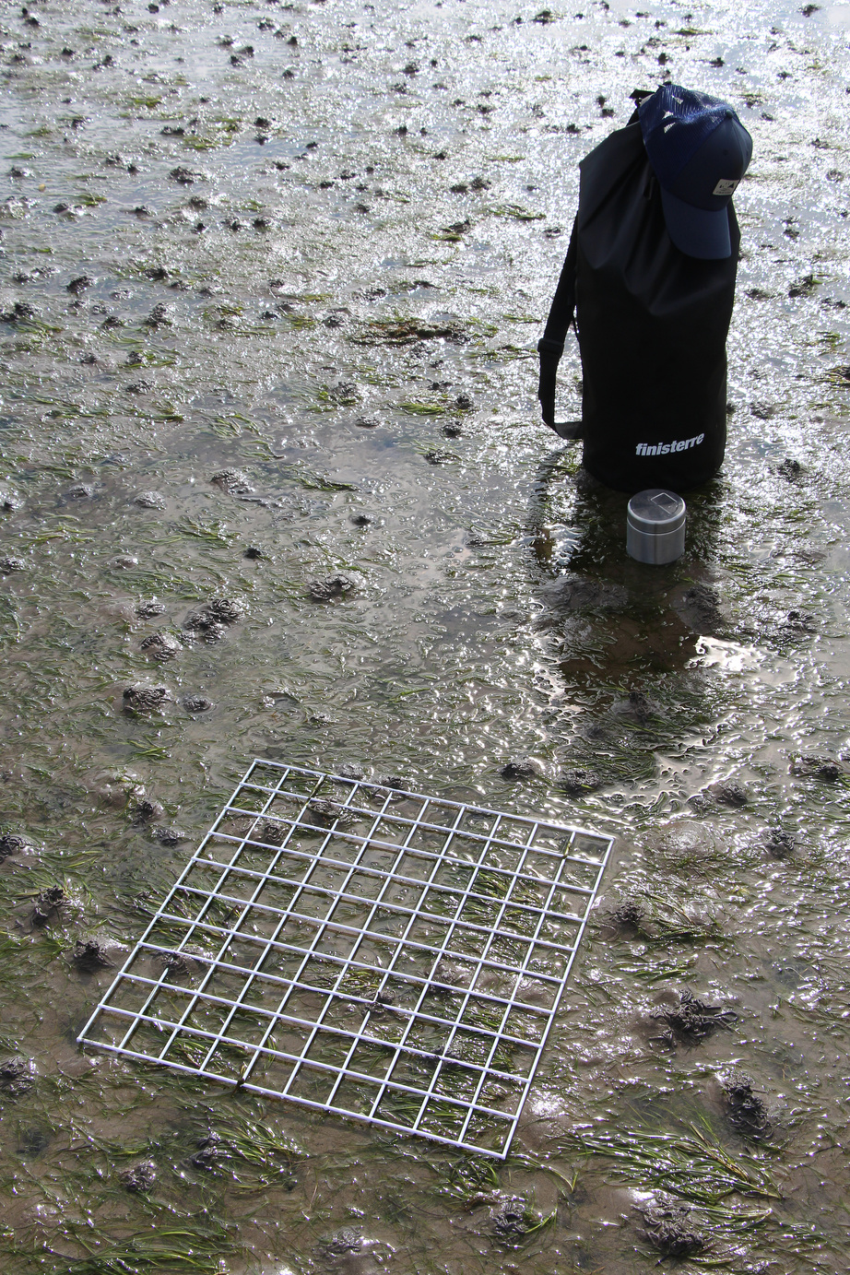
WHY DO PEOPLE WORK IN CONSERVATION?
Conservation work is really rewarding, and there are so many ways that people can get involved in helping to protect our natural world! It takes a vast amount of varied skills in order to understand how best to protect or restore a species, from knowing how it behaves, to understanding the threats it faces, and how to work with people so they change to more environmentally friendly behaviours.

Slide 4
WHO CAN WORK IN CONSERVATION?
Anyone! Having a wide variety of different people is brilliant in any workplace, but especially in conservation! We need people with different ideas, different skills, and different ways of thinking to help us come up with creative ways to succeed...

Slide 5
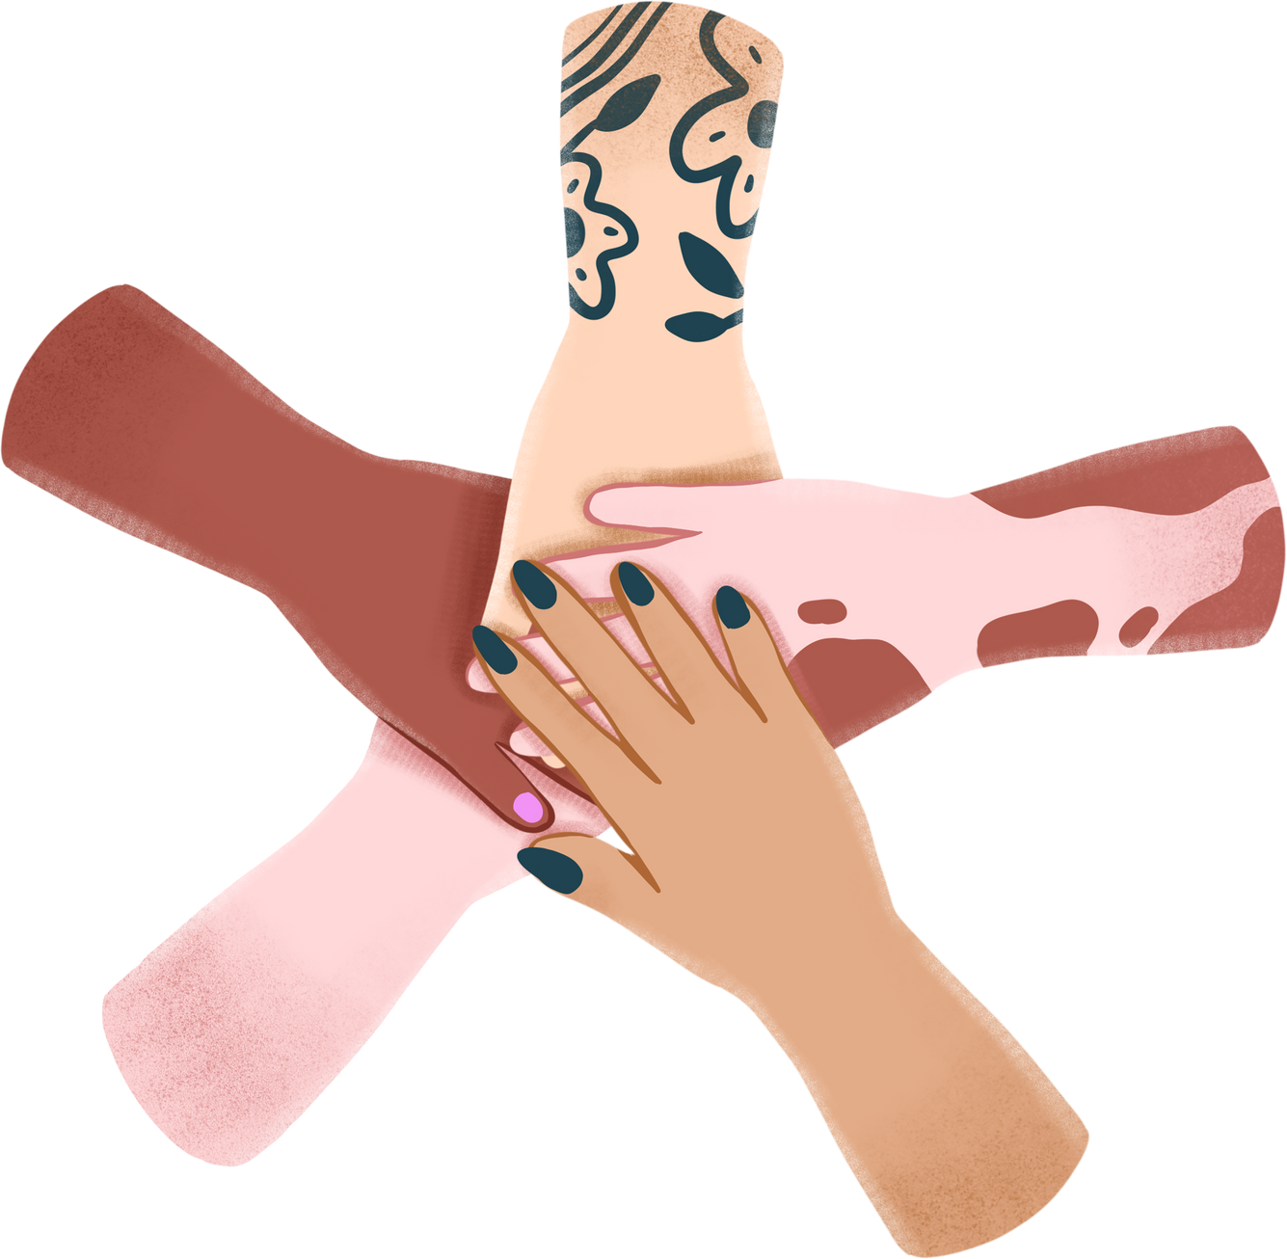
WHO CAN WORK IN CONSERVATION?
Just now, diversity in conservation is low, so we are all losing out - we need new perspectives, new insights, and an understanding of what is important to everyone, so we are making sure that our work is fair for all!

Slide 6
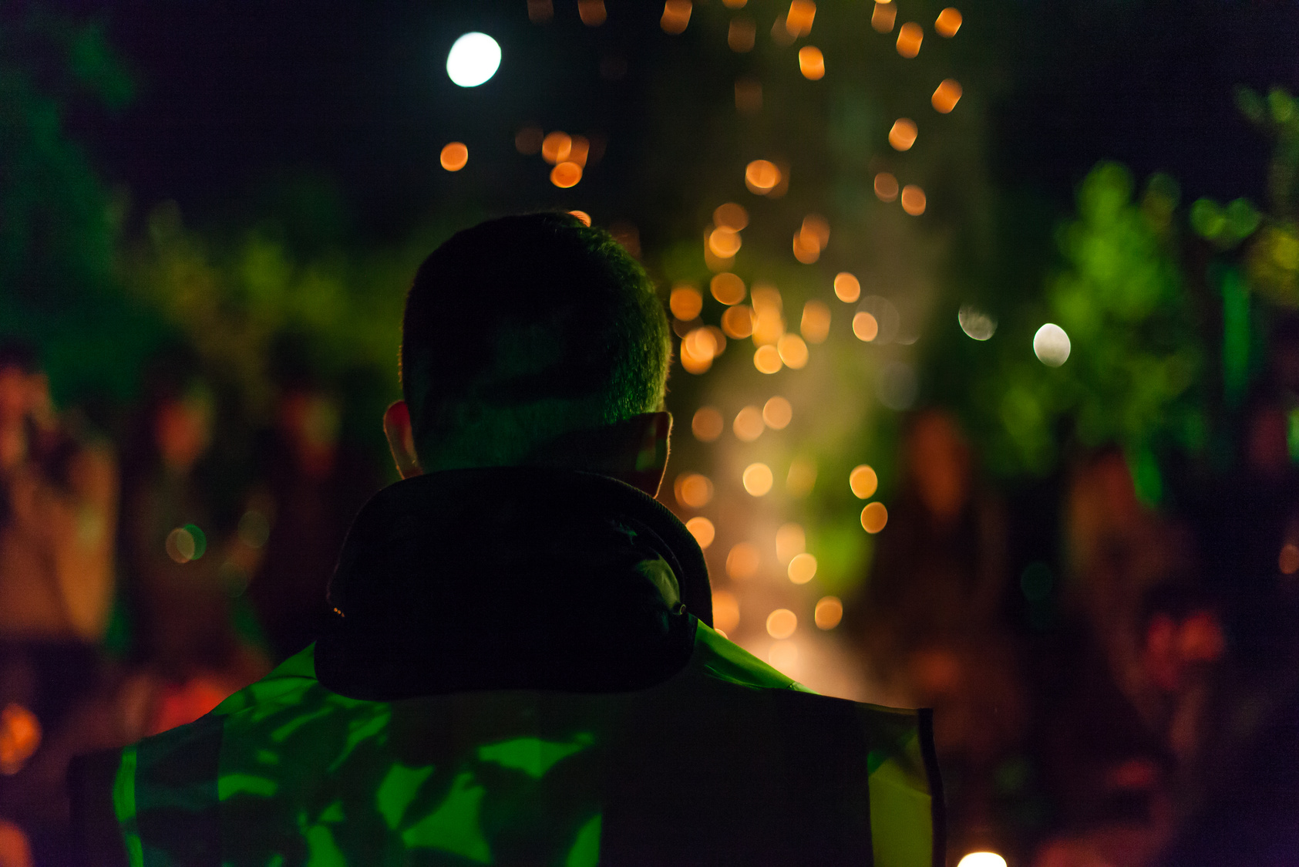
WHO CAN WORK IN CONSERVATION?
Different people value different habitats/ areas/ species and whilst we strive to protect all nature, it’s important that we focus our efforts in a way that is fair to everyone!

Slide 7

WHAT TYPES OF JOBS ARE THERE IN CONSERVATION?
Conservation work is like a jigsaw, we need to bring together the many pieces in order to get the full picture! This includes those on the ground helping to coordinate volunteers, and doing the practical work, to those undertaking research to understand the problem and create solutions.

Slide 8
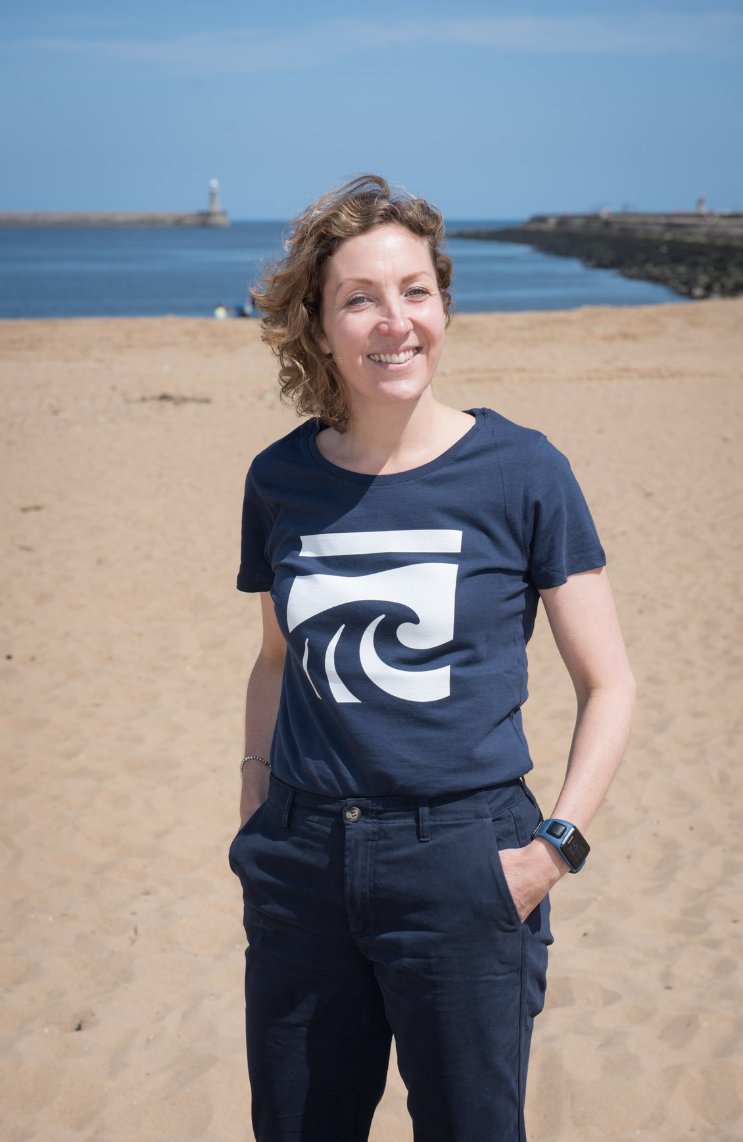
WHAT TYPES OF JOBS ARE THERE IN CONSERVATION?
We also need people that work to bring in funding, those that bring together different people with different skills to make the project a success, leading on overseeing the project and making sure everyone has what they need to do their work, and of course there are those that share and communicate about the work, so others can learn from it too!

Slide 9

LET’S EXPLORE SOME ROLES!
Let’s delve deeper into some roles in conservation, and see what is needed, and try our hand at some of these roles ourselves!

Slide 10
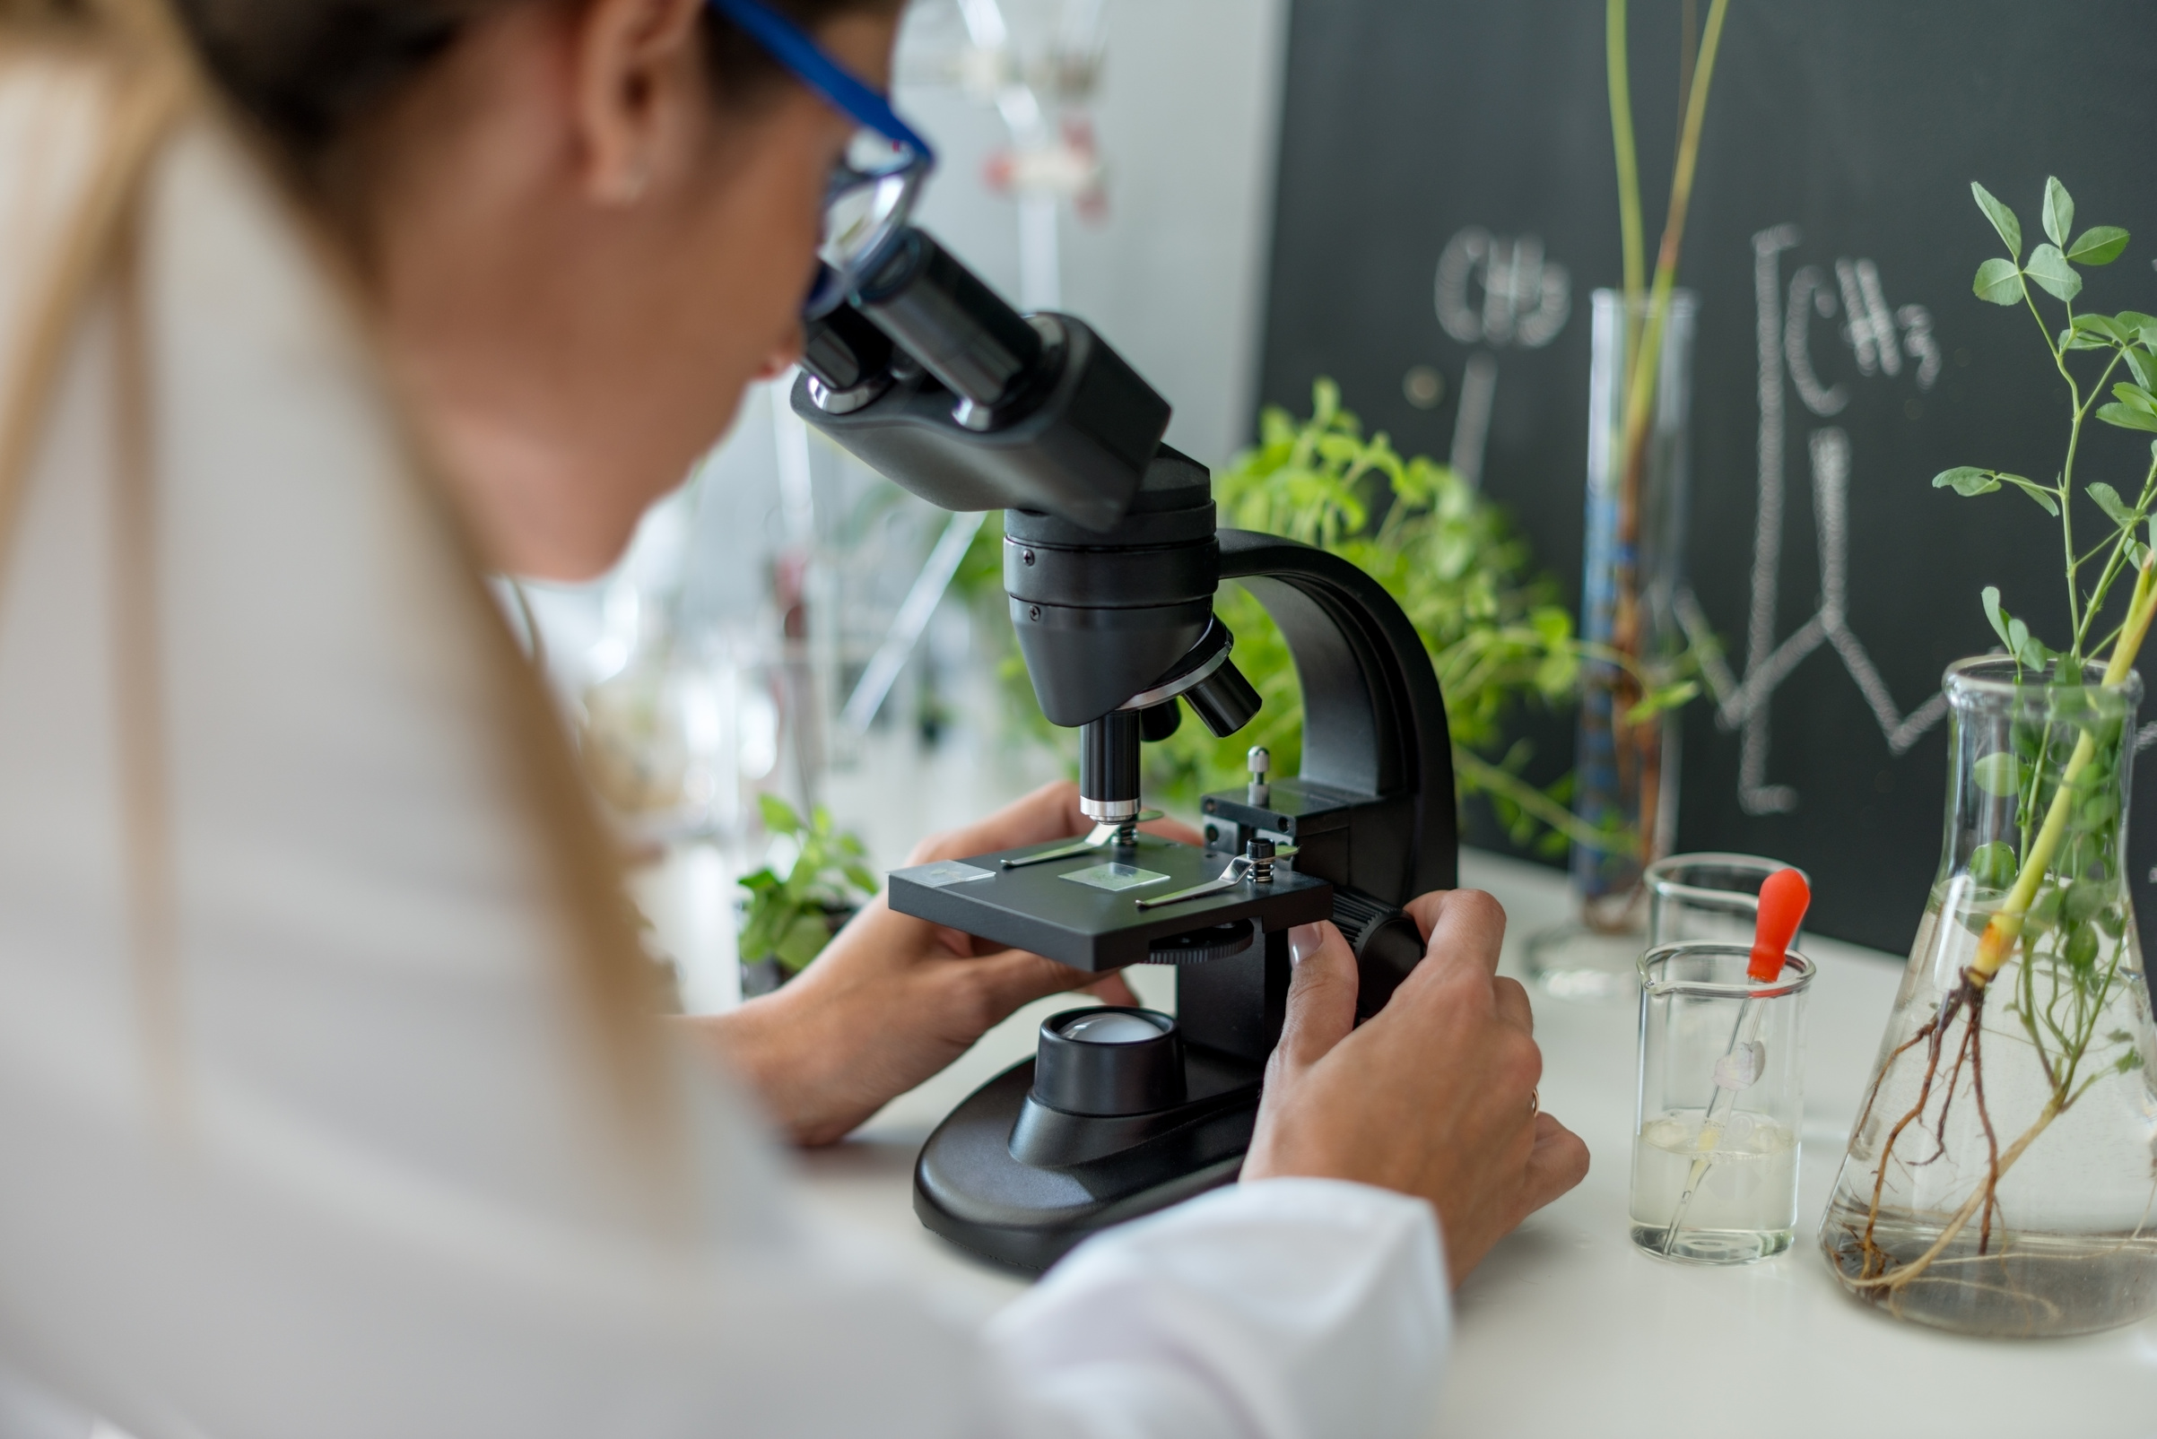
RESEARCHER
Researchers, also known as scientists, answer questions about the world around them. No question is too big or too small! They then have to figure out a way to answer that question while gathering proof to support their answer...

Slide 11

RESEARCHER
To conduct a scientific investigation, there is a typical process that is followed...

Slide 12

RESEARCHER
First, we start by identifying a question we want to answer, let’s use an example:
“Would oysters prefer to grow on sand, mud or rock?”

Slide 13

RESEARCHER
Now we come up with what we call a ‘hypothesis’, this is what we think the answer is, it is a prediction! For example, in this case:
“Oysters prefer to settle on top of rock”

Slide 14
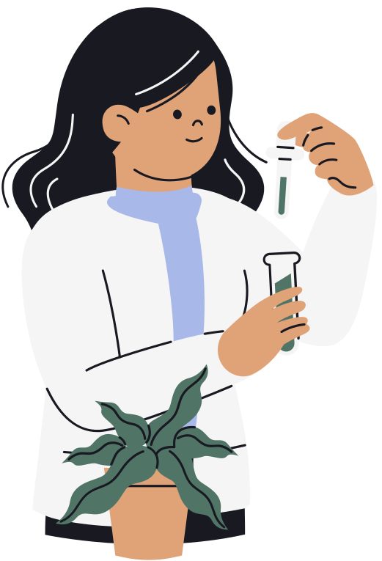
RESEARCHER
Now we have to test this, by conducting an experiment, for example, this is called our method:
“I have 150 oysters, I’ll place 50 on sand, 50 on mud, and 50 on rock, and I’ll record them over a year, and see which is growing the best”

Slide 15

RESEARCHER
As we run our experiment, we record our results, so we have records of what is happening. In the case of our example, we might see:
“Only 5 oysters on the sand remain, and 3 on the mud, whilst there are 46 oysters still on the rock.”
It’s important that experiments are designed to only change one thing, so we know that it is that which is affecting our results! We call the thing being changed the ‘Variable’.

Slide 16
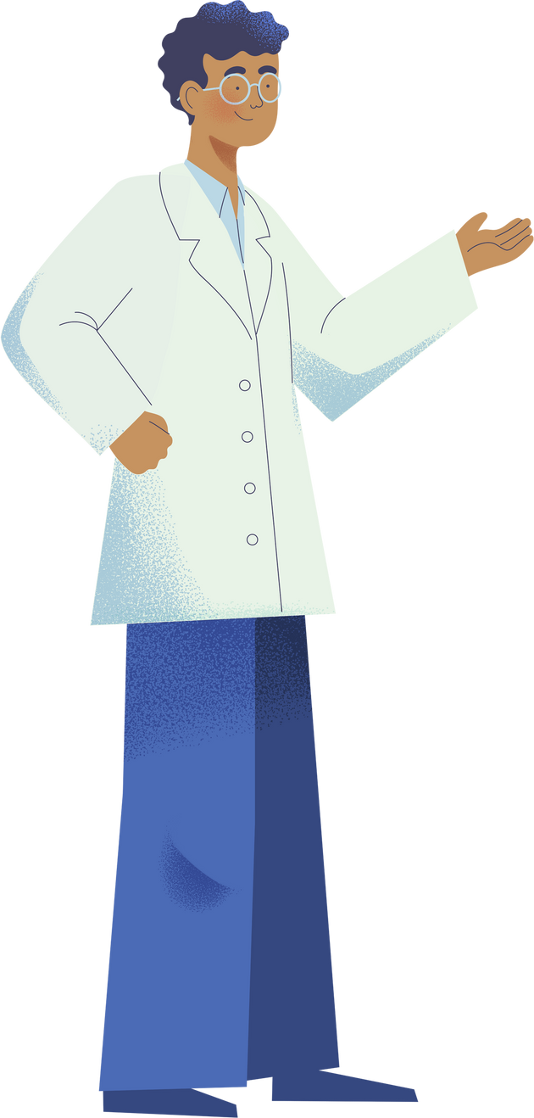
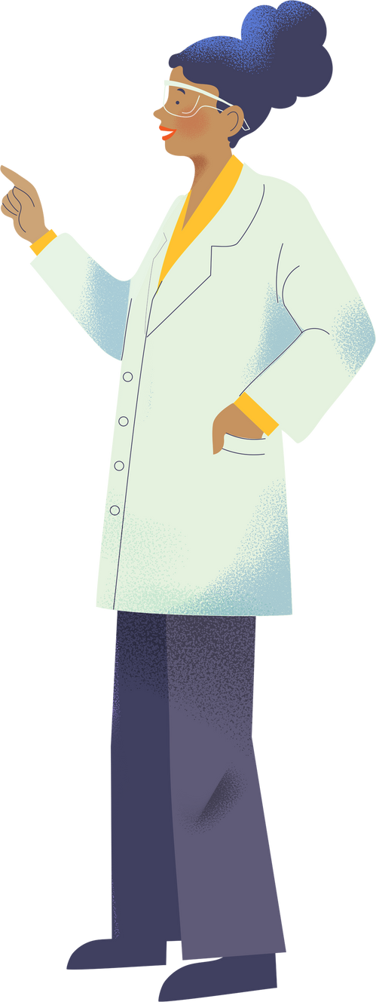
RESEARCHER
We then interpret our results, that is to say we look at our results, and figure out what they tell us.
“The oysters on the rock are the only oysters that grew well, because the other oysters couldn’t hold on to the sand or the mud, so oysters must prefer to grow on rock”.

Slide 17
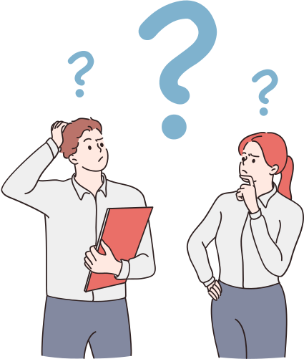
ACTIVITY
Think of a question that you would like to answer about our natural world. Consider what your hypothesis would be, and how you would investigate it. You won’t be conducting the experiment so it can be as big or as small as you like!

Slide 18
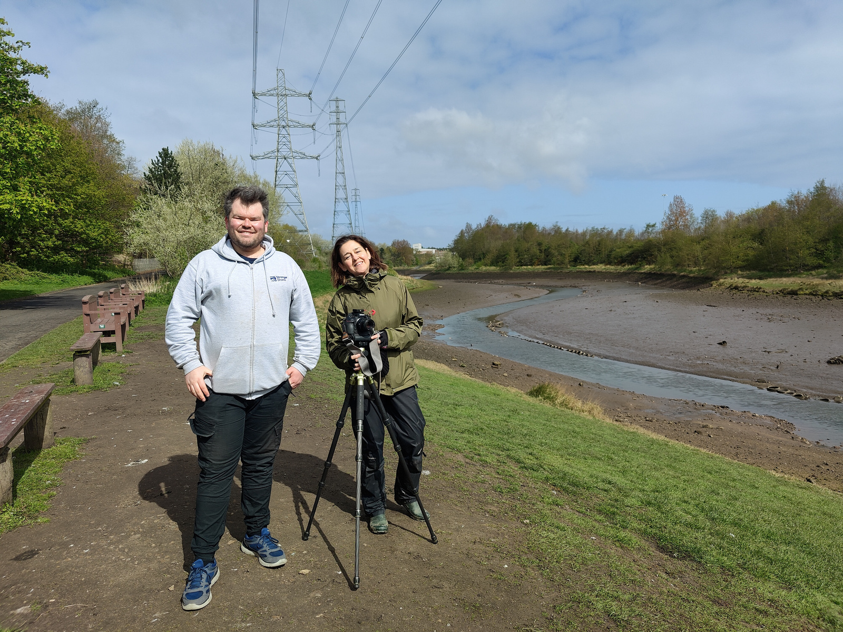
COMMUNICATOR
Science is incredibly important, but so is telling people about it! How else could we use the information that we discover? Science communicators are people who love science, and can find ways to tell people about it creatively, to help others understand. They can do this in so many ways, for example through films, art, writing, and even games!

Slide 19

ACTIVITY
Research a piece of science that interests you, it can be any topic you like - environmental, space, chemistry - you choose!
Using a piece of paper, write and illustrate a social media post that you could create to communicate this science. You have a word limit of 240 words, and you’ll need 1 image (draw or sketch what it would be).
Tip: consider what else you could use to better communicate your post - tags, hashtags, emoji’s etc.

Slide 20
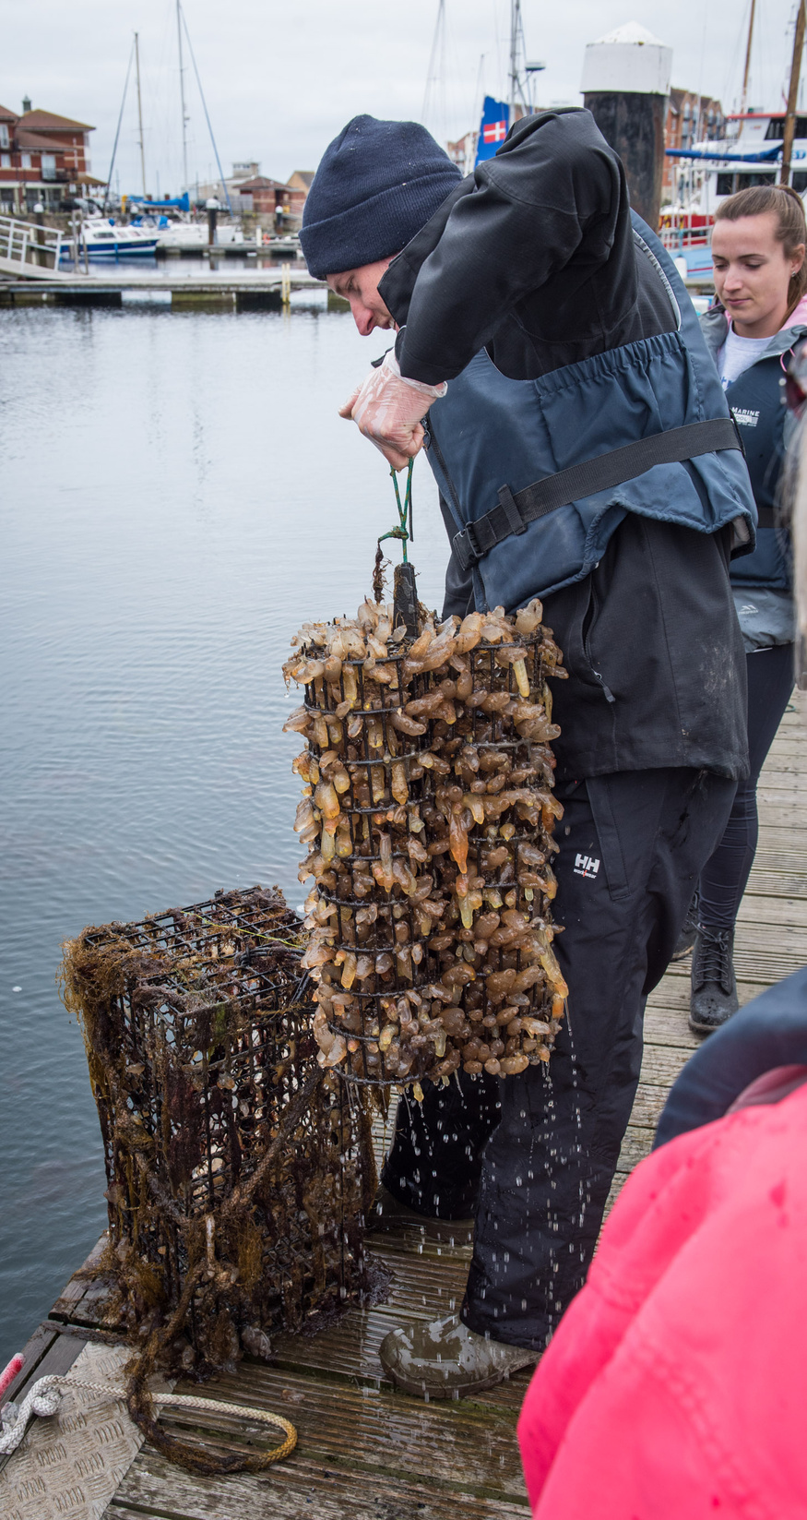
CONSERVATIONIST
Conservationists are scientists, but more often they put the science into action as well, using what science tells us to inform how best to protect, and even restore our natural world!

Slide 21
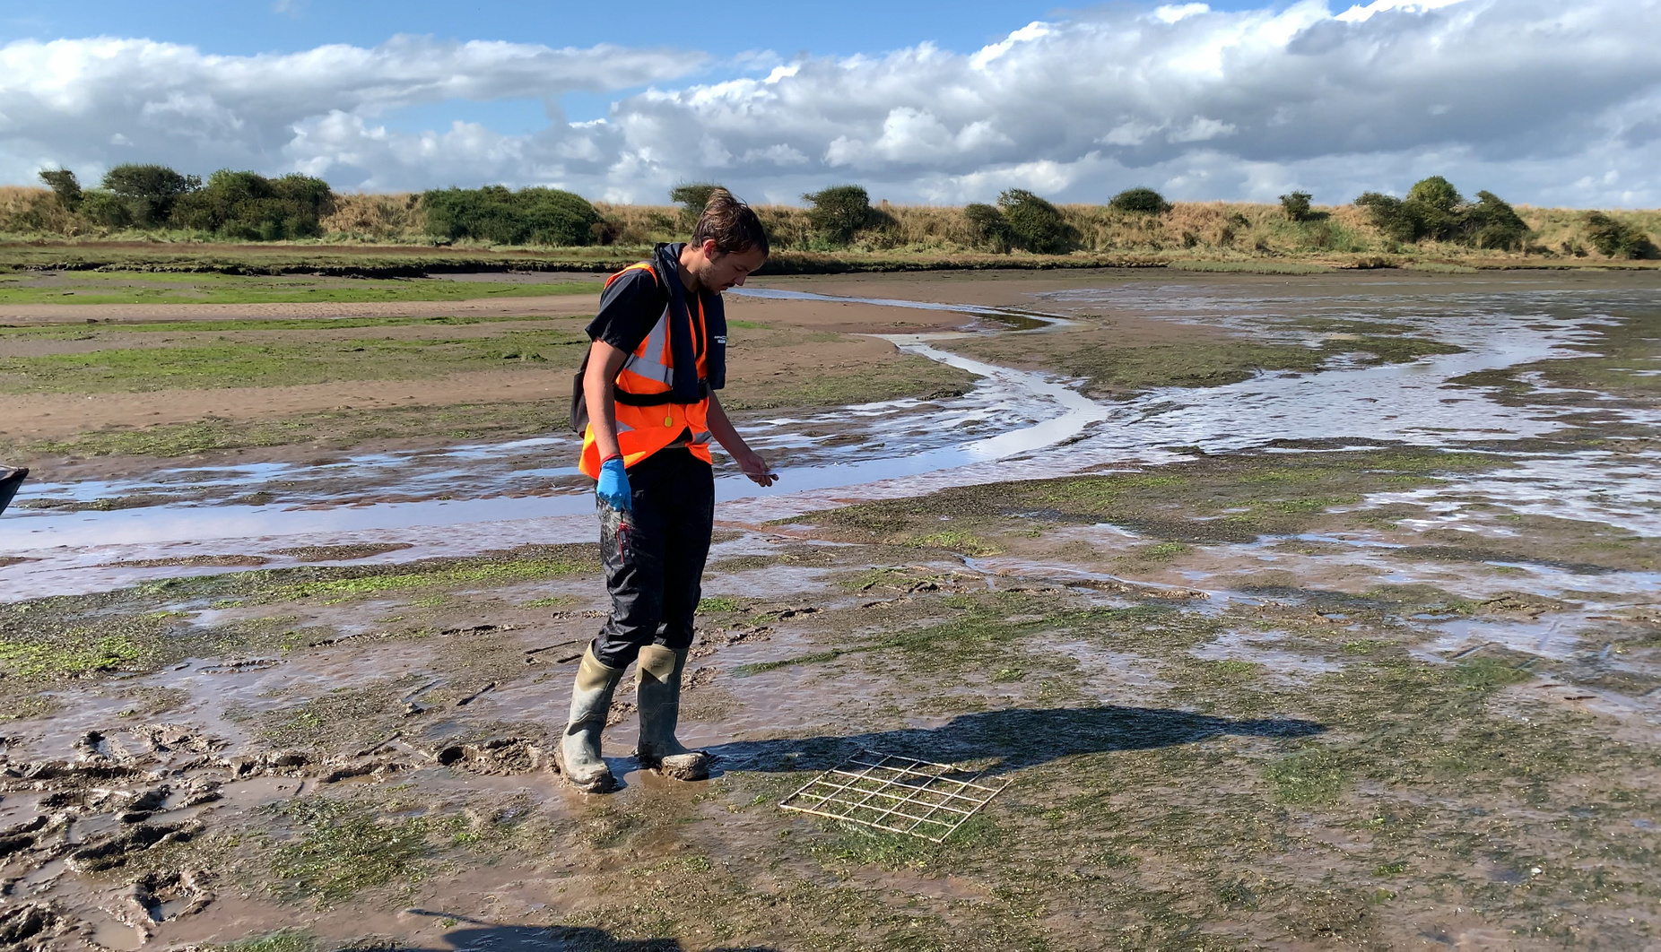
CONSERVATIONIST
From trudging through mud to snorkelling, from heading out on the boat to sitting at the desk and looking at maps, it’s a varied and fun job!

Slide 22
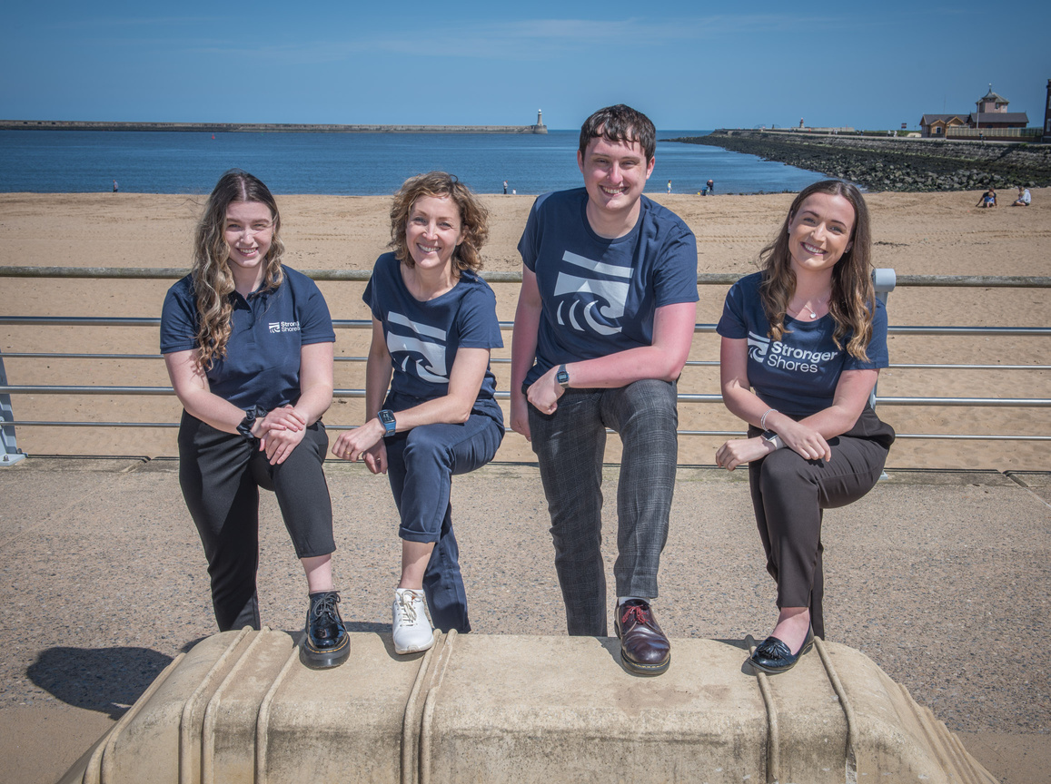
PROJECT TEAM
All of these roles are important, but to bring them together and make use of these roles and their skills requires a project team, people to oversee the job, to take charge and oversee spending money, and track the success of the project.

Slide 23
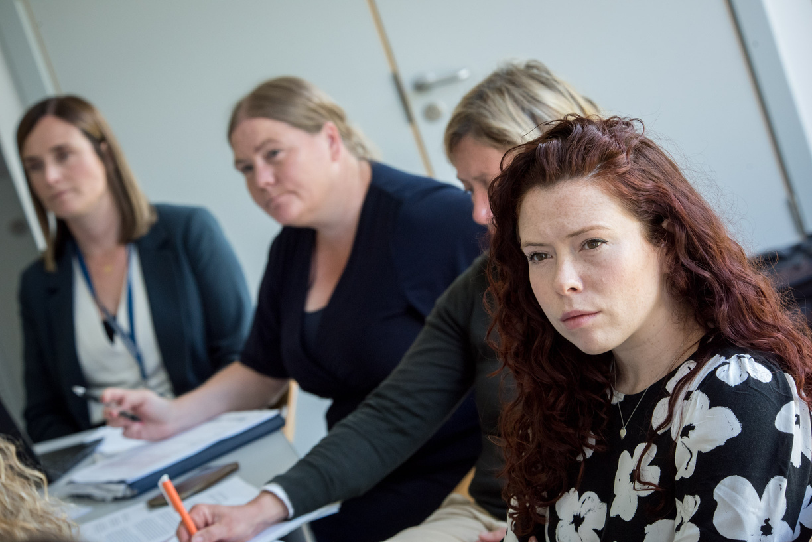
PROJECT TEAM
It is also important for the team to reach out and build relationships between the scientists, conservationists and communicators so everyone can work well together, requiring strong people and communication skills.

Slide 24
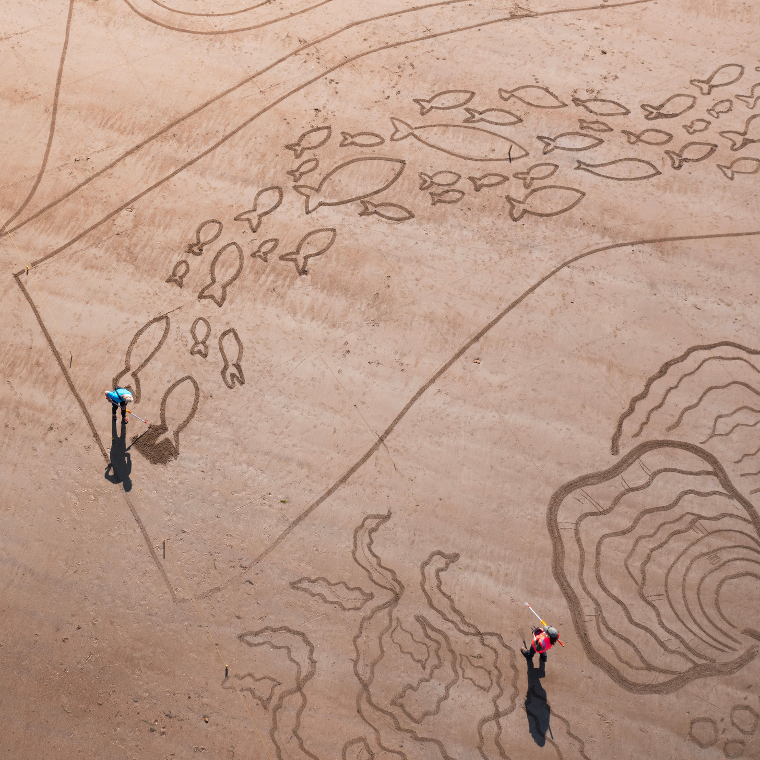
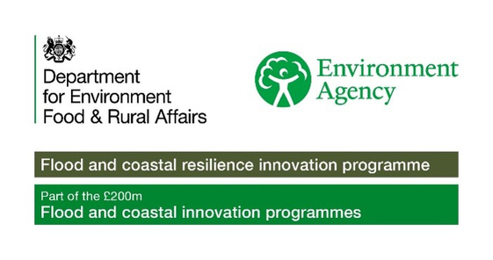

ACTIVITY TIME
In this section you can now complete the associated quiz, and can do the activity in the accompanying pdf!

