Slide 1

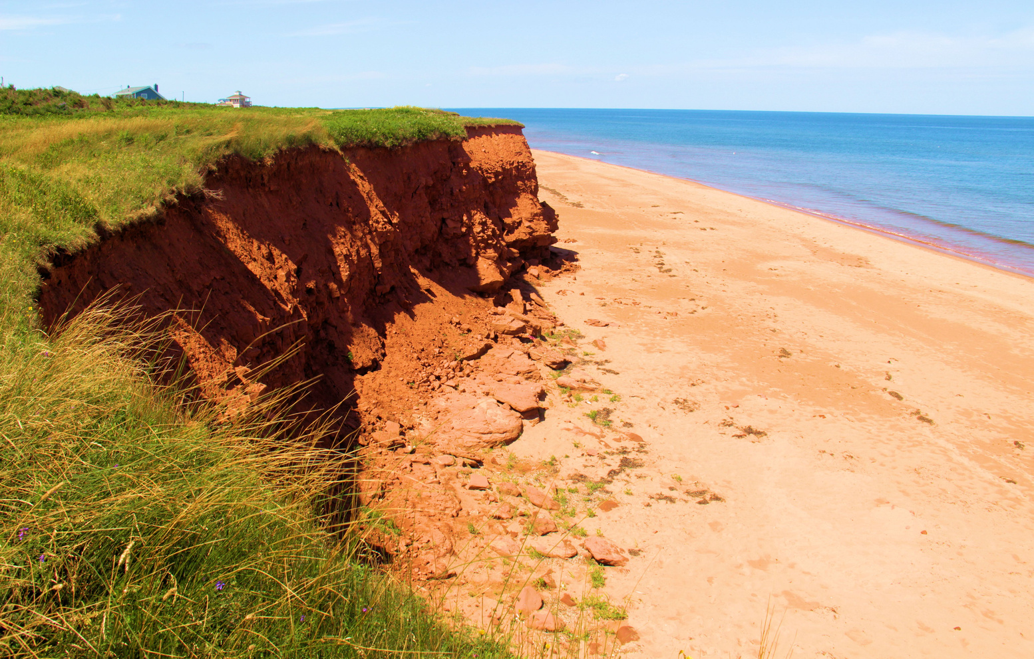
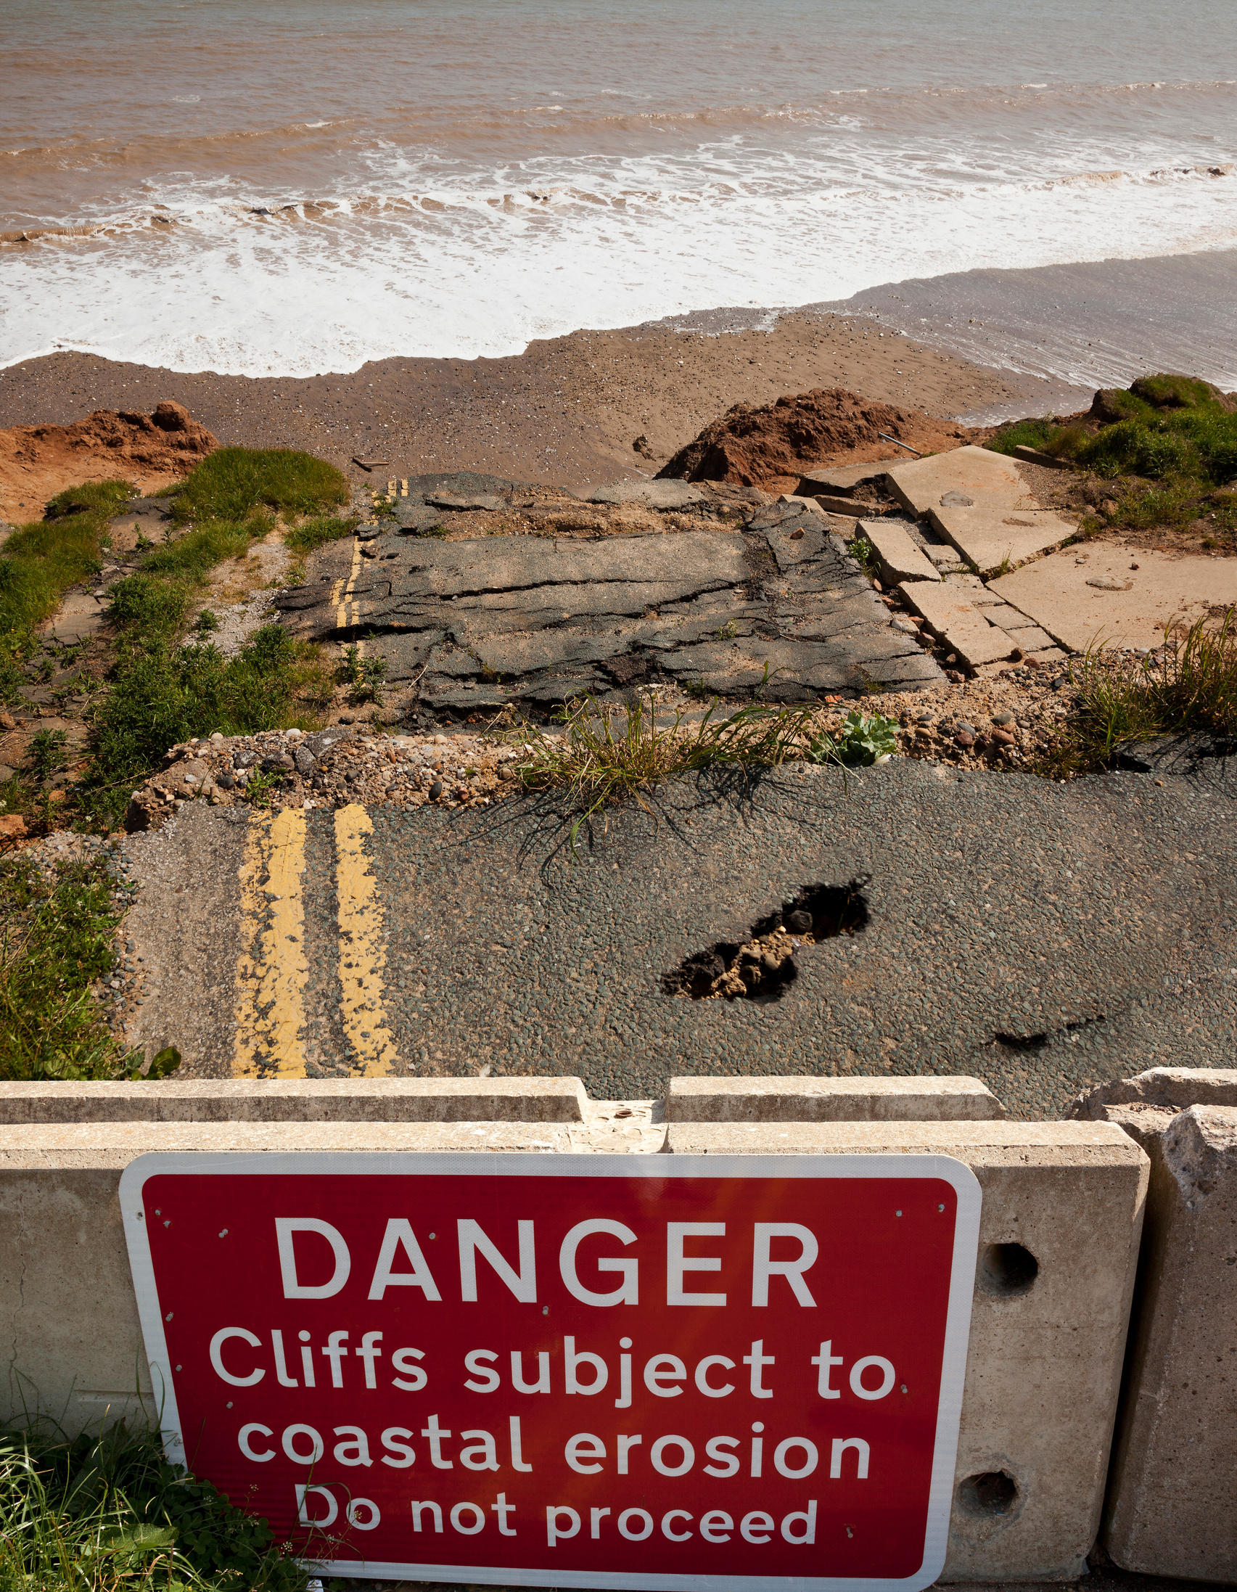
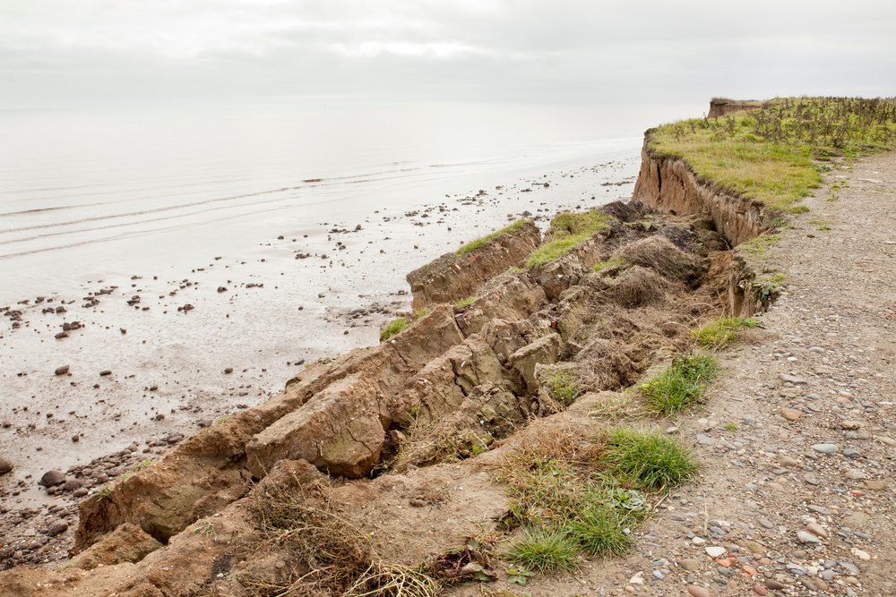

EROSION
Explore the impact of climate change on our coastlines...

Slide 2
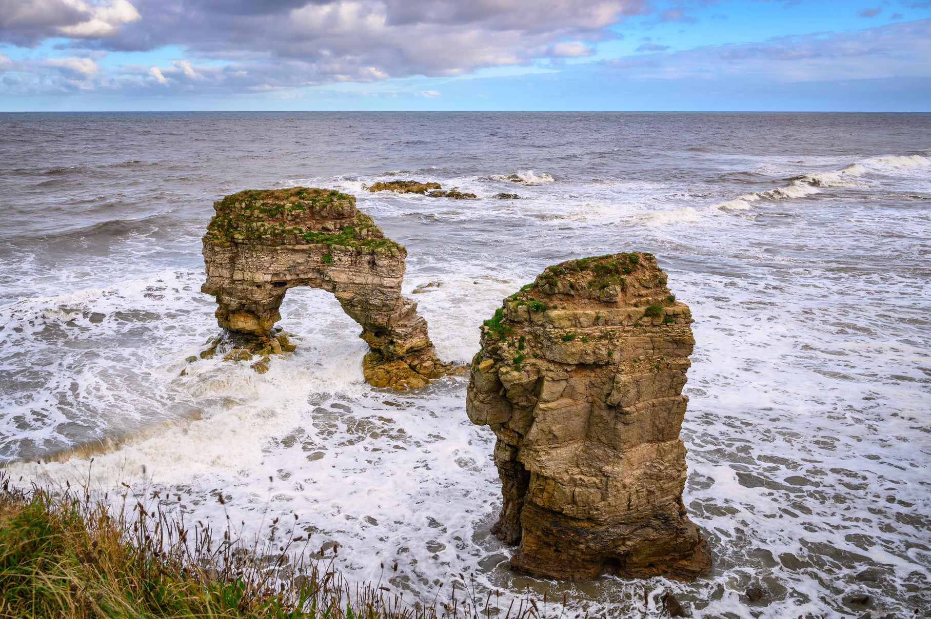
LEARNING OUTCOMES
By the end of this presentation you will have learned:
  Why coastal geology is important
  The difference between hard and soft engineering
  The pros and cons of each
  How our coastal defences are managed

Slide 3
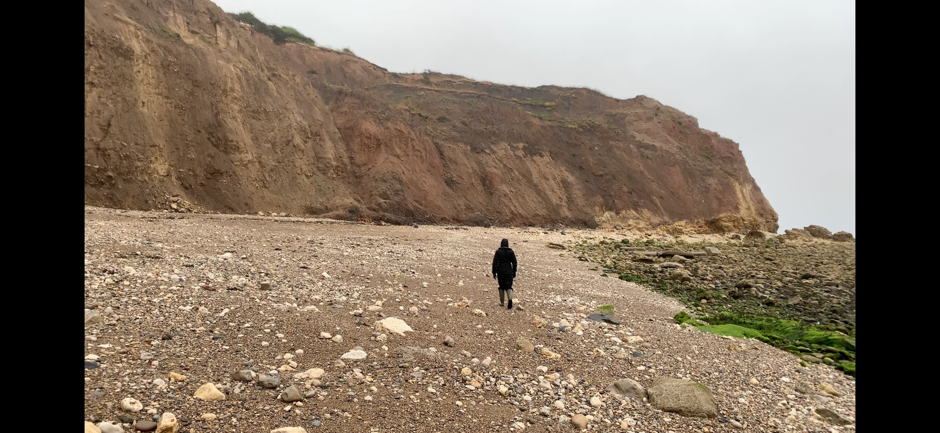
GETTING TO KNOW THE COAST
List some features you might find at the coast:
  Cliffs
  Beaches
  River Mouths
  Mudflats
  Rocky shore
  Harbours

Slide 4
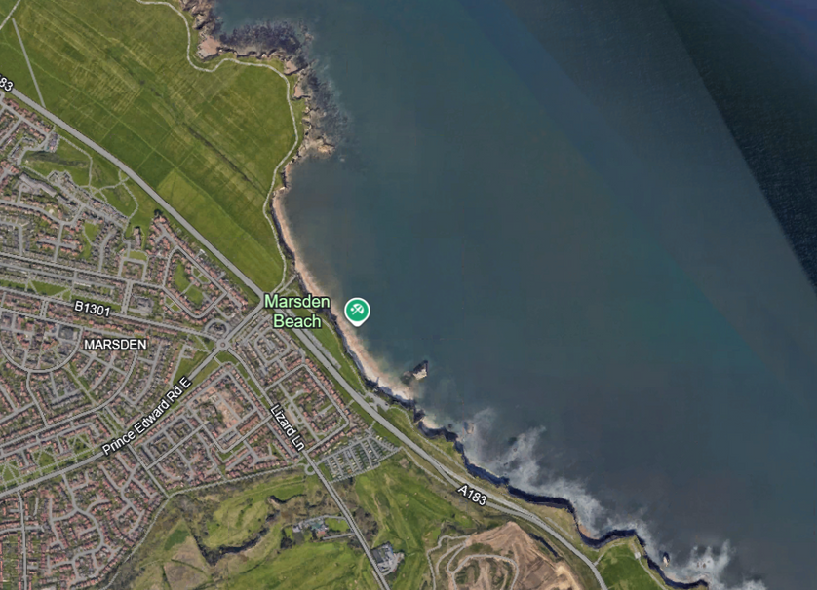
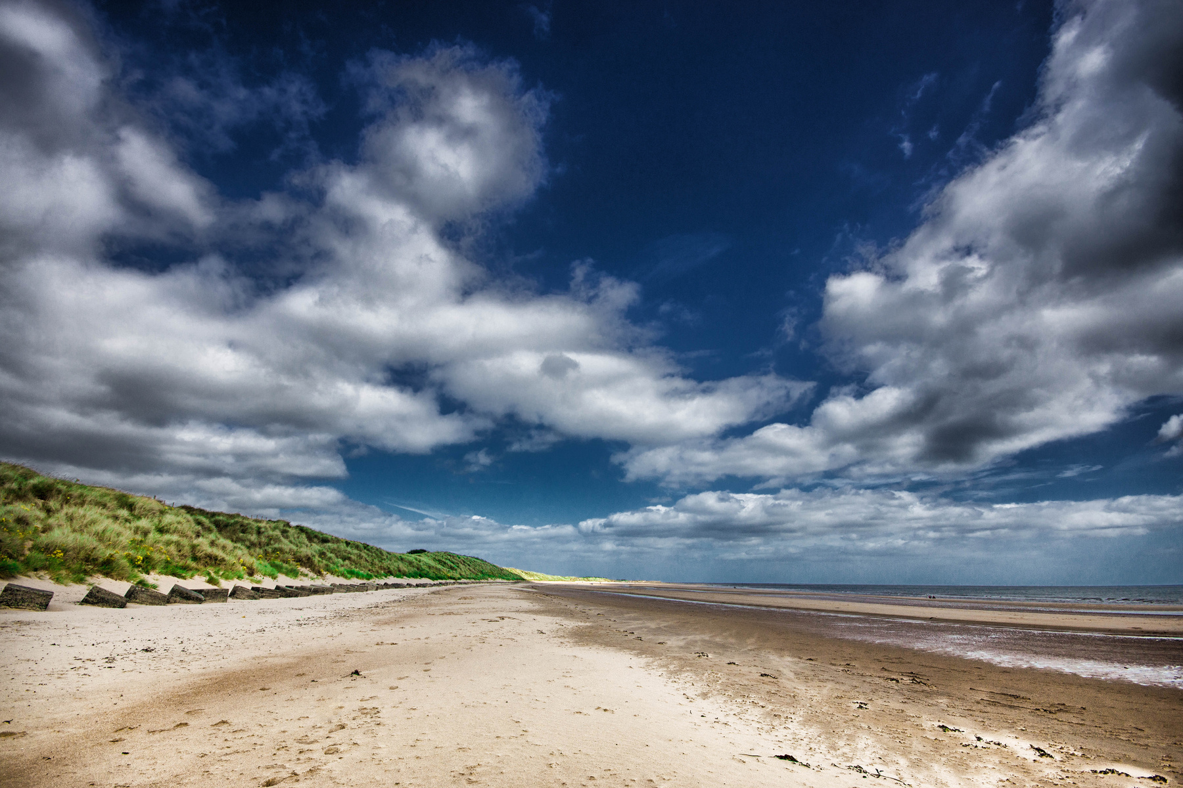
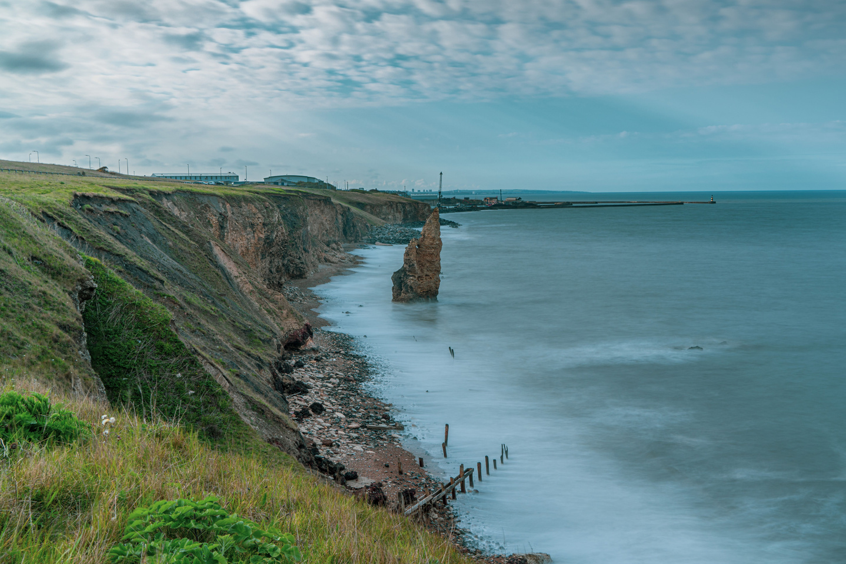
GETTING TO KNOW THE COAST
Coasts are always changing, but what does a typical coast look like?
The way that the coast looks depends upon the way the water moves in the area, nearby rivers, and the type of rock in the area...

Slide 5



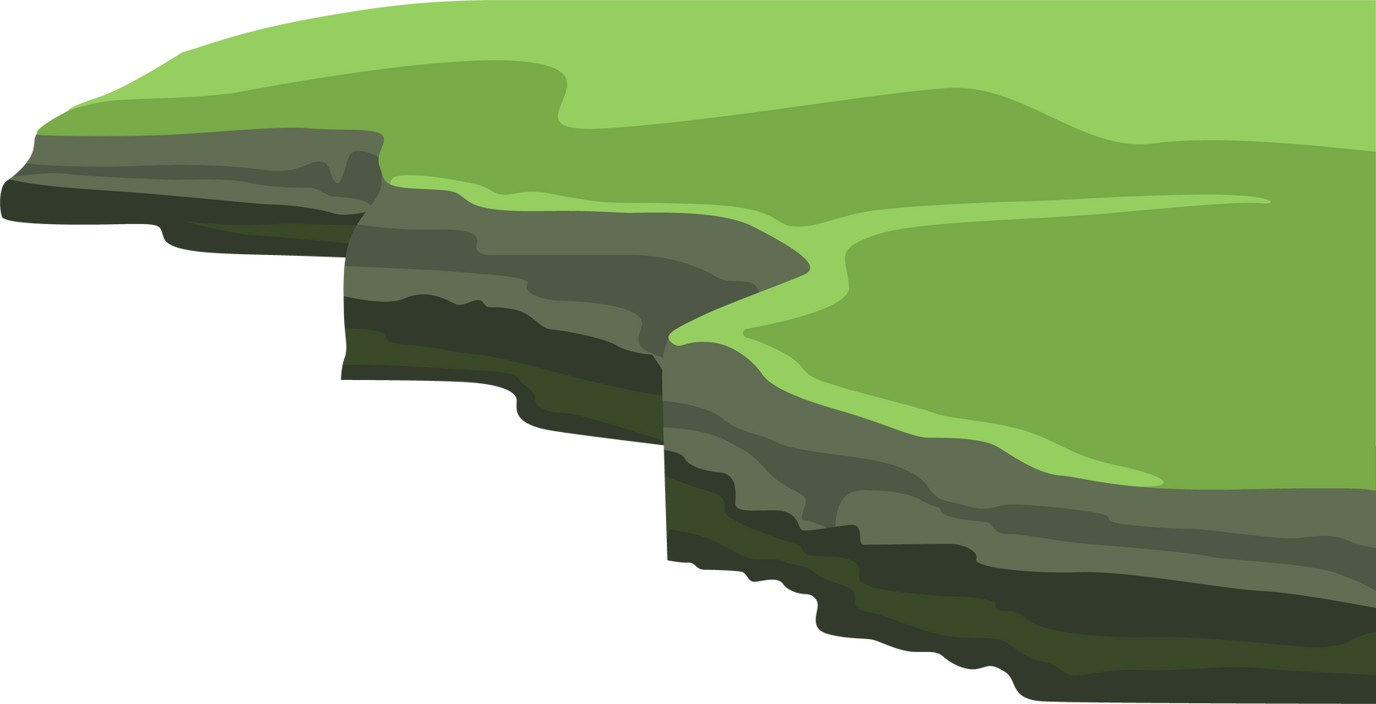

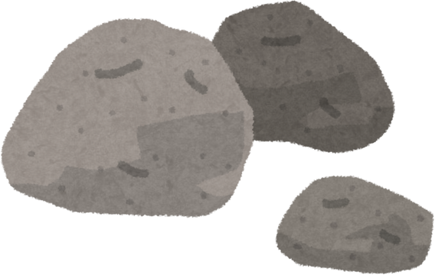
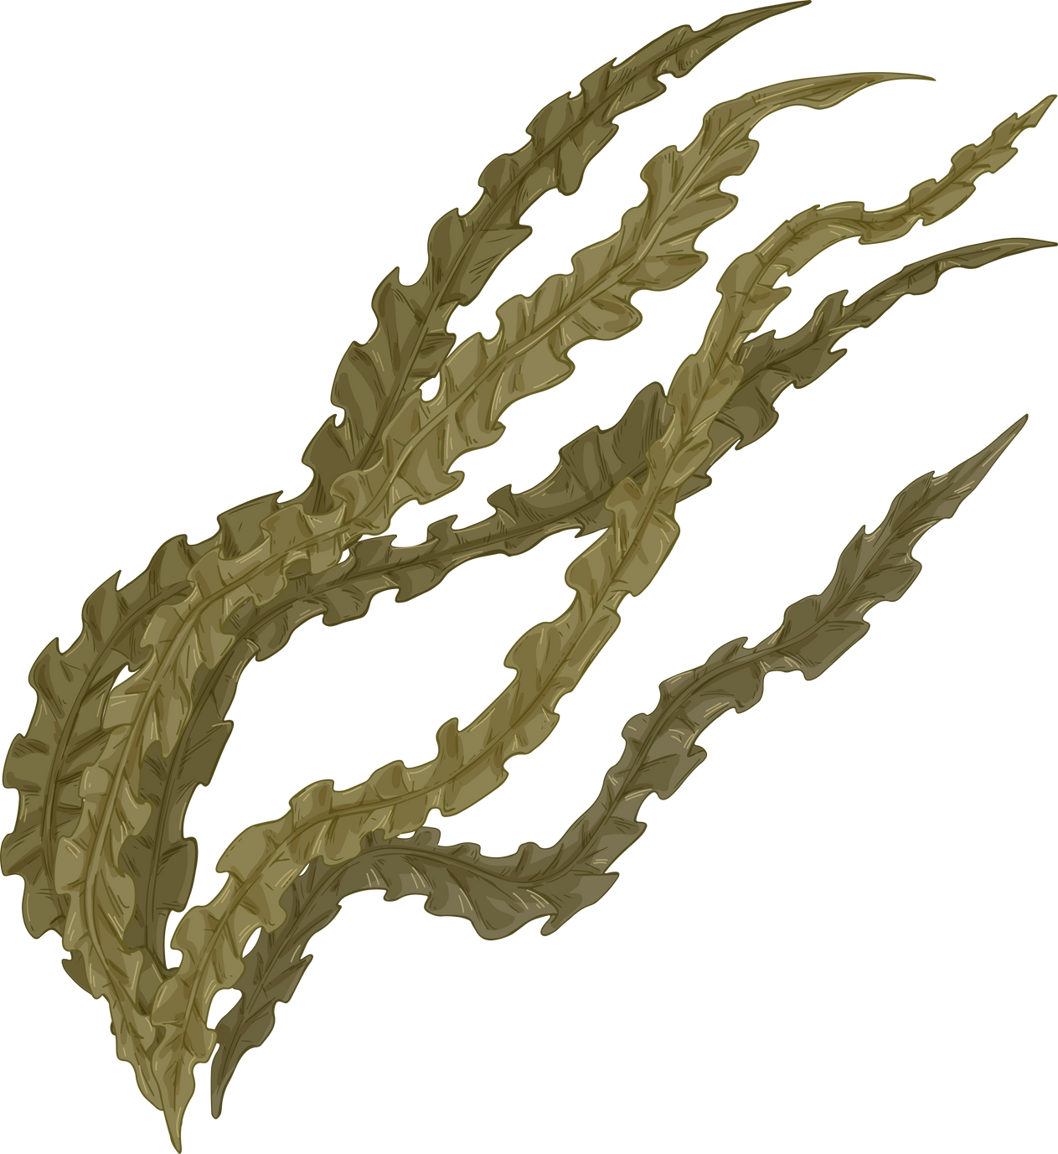
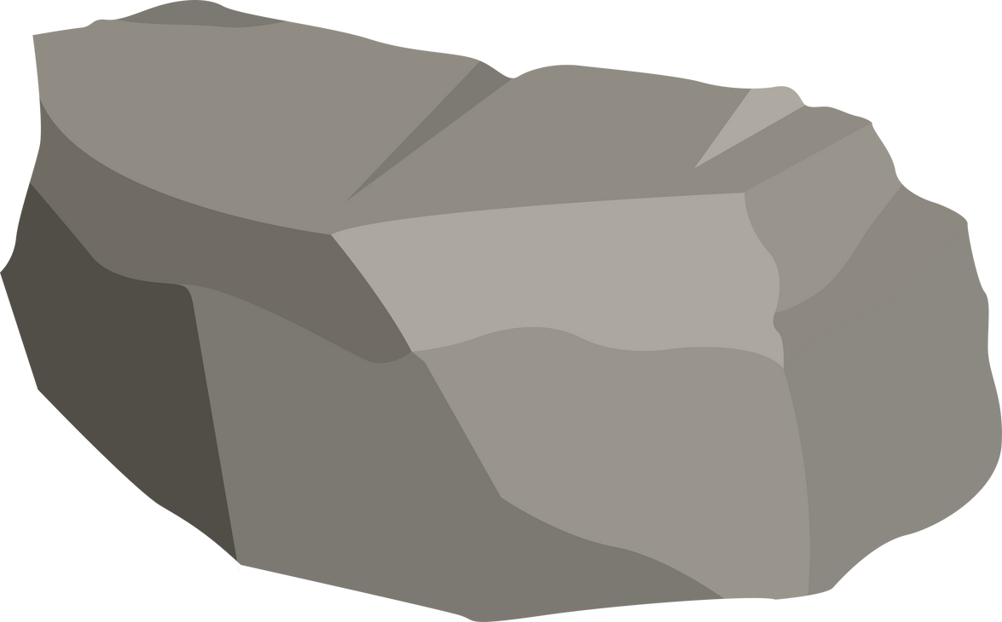
WHY IS GEOLOGY IMPORTANT?
The coast is made up of different types of rock, some harder than others.
The softer rock erodes faster than the harder rock, and that leads to the formation of bays and headlands.
Headland
Headland
Bay
Headland
Bay

Slide 6


GEOLOGY ROCKS
HARD ROCK
HARD ROCK
SOFT ROCK
SOFT ROCK
HARD ROCK
HARD ROCK

Slide 7
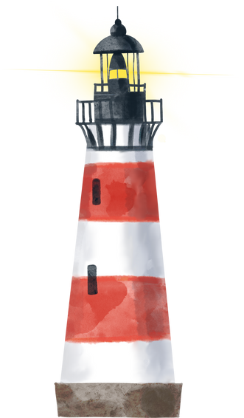
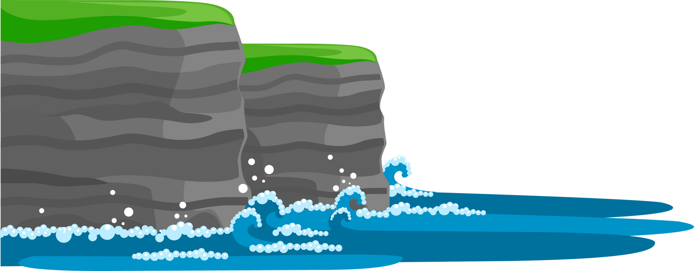




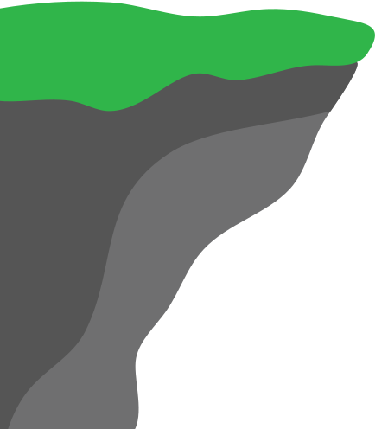
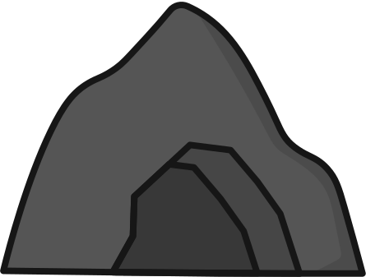

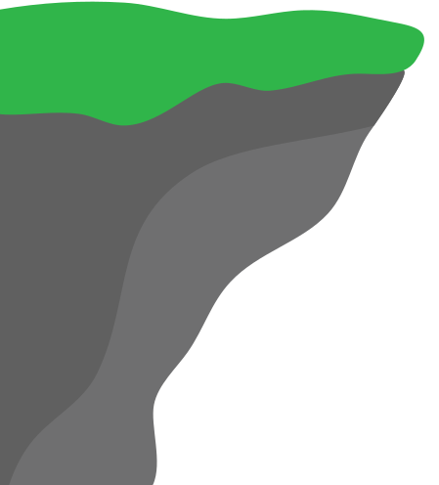




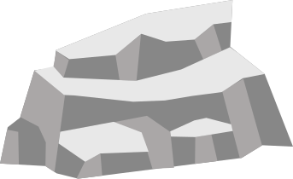
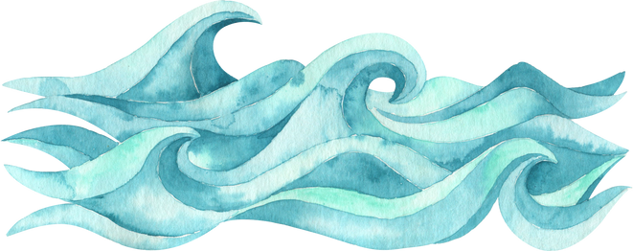
HEADLANDS
Eventually the Headlands recede as well, in a pattern that creates features you may be familiar with...
CRACK > CAVE > ARCH > STACK > STUMP > NOTHING

Slide 8
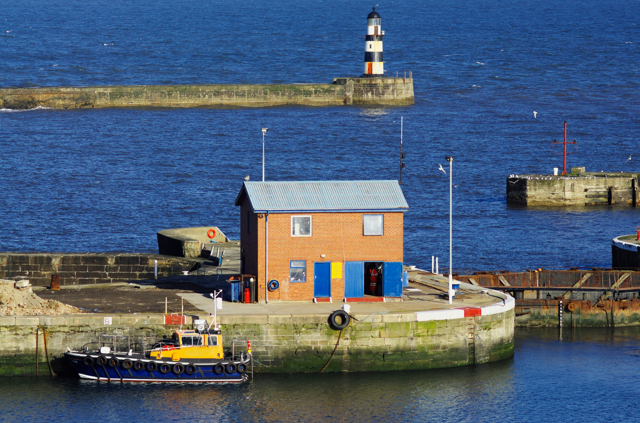
A THREAT TO US
We have been building along the coast for millennia - why do you think humans want to live & work by the sea?
Trade
Fishing
Scenery
Recreation
Good for wellbeing
...

Slide 9

COASTAL MANAGEMENT
There are different ways that we can manage our coastline. Local authorities decide, using what is called a cost-benefit analysis, on what areas of the coast we should spend money on to reduce erosion, and what areas that we must leave to erode as it would be too costly otherwise...

Slide 10
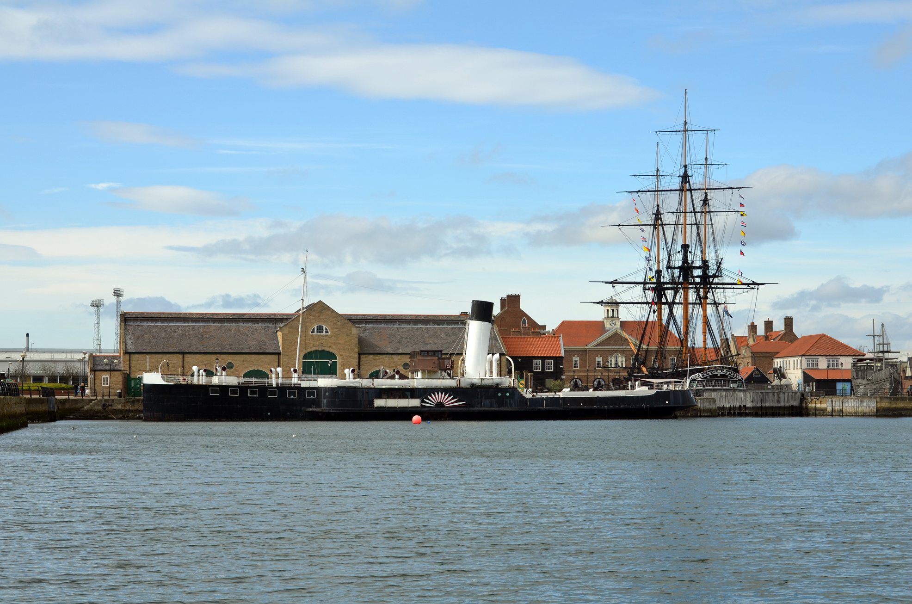
COASTAL MANAGEMENT
Have a discussion, and think about your local coastal area, what would you protect, and why?
Is it a business, homes, a historical landmark, maybe even your favourite beach?

Slide 11
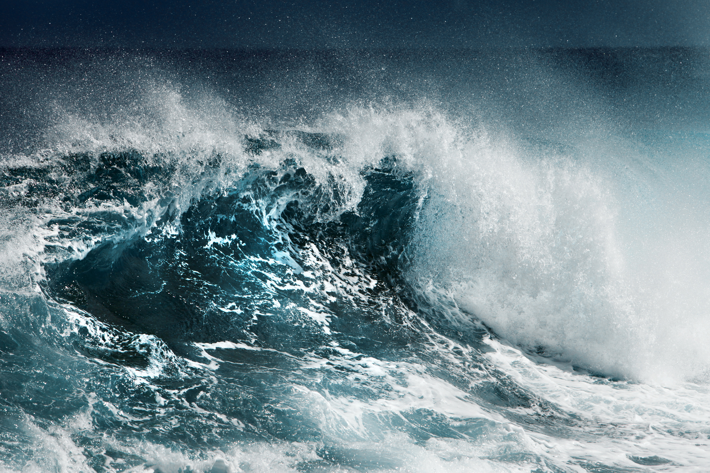
COASTAL DEFENCES
There are 2 types of coastal defences that we can employ:
Hard Engineering
Soft Engineering

Slide 12
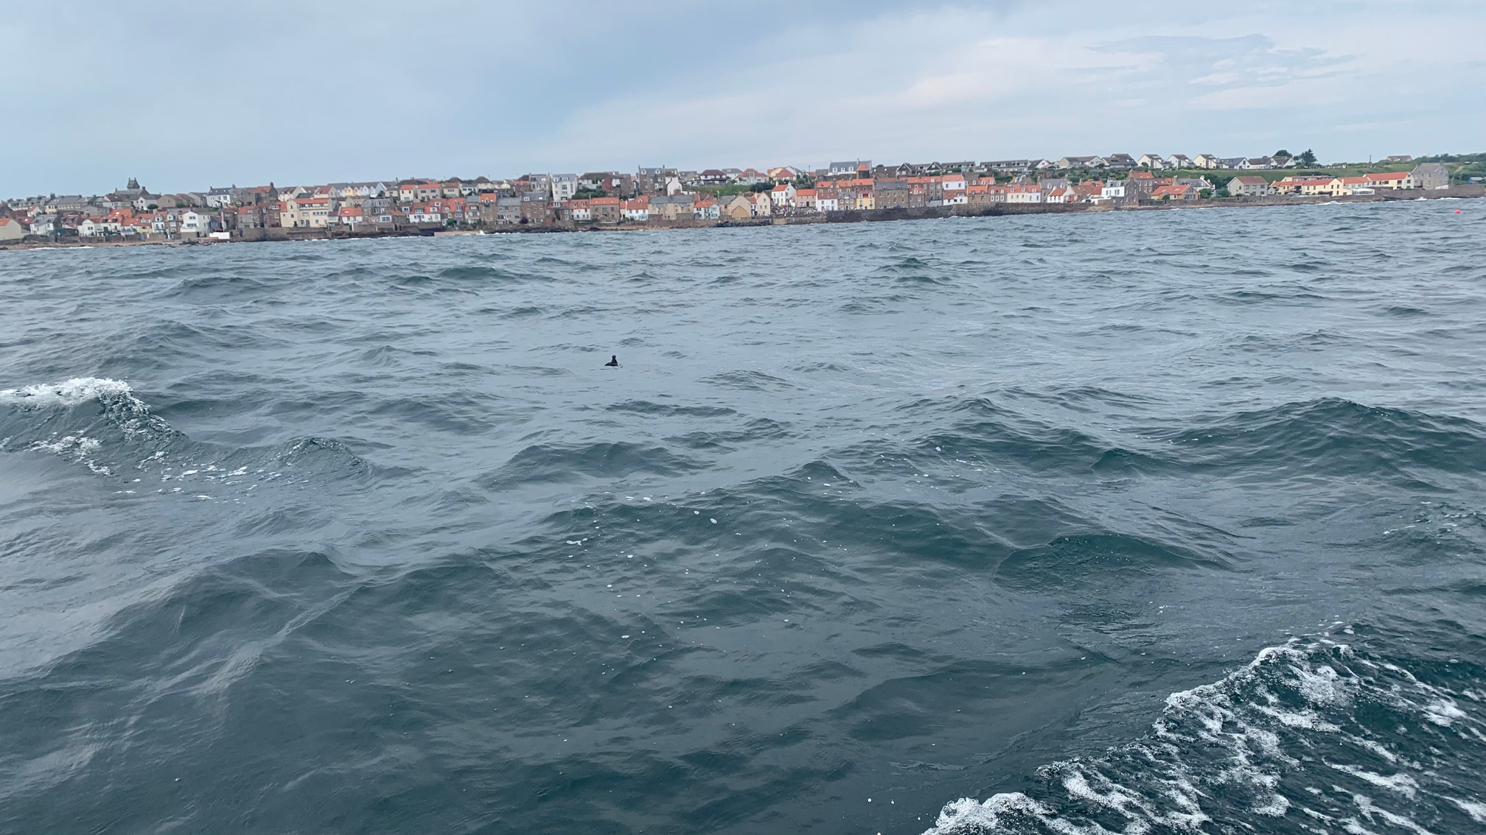
HARD ENGINEERING
This includes built defences, such as...

Slide 13
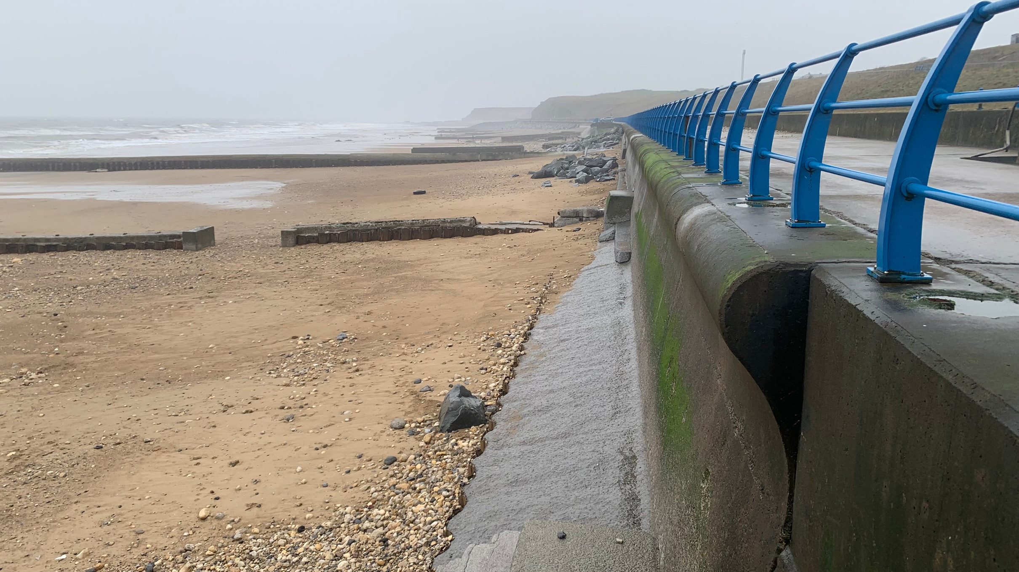
SEA WALLS

Slide 14
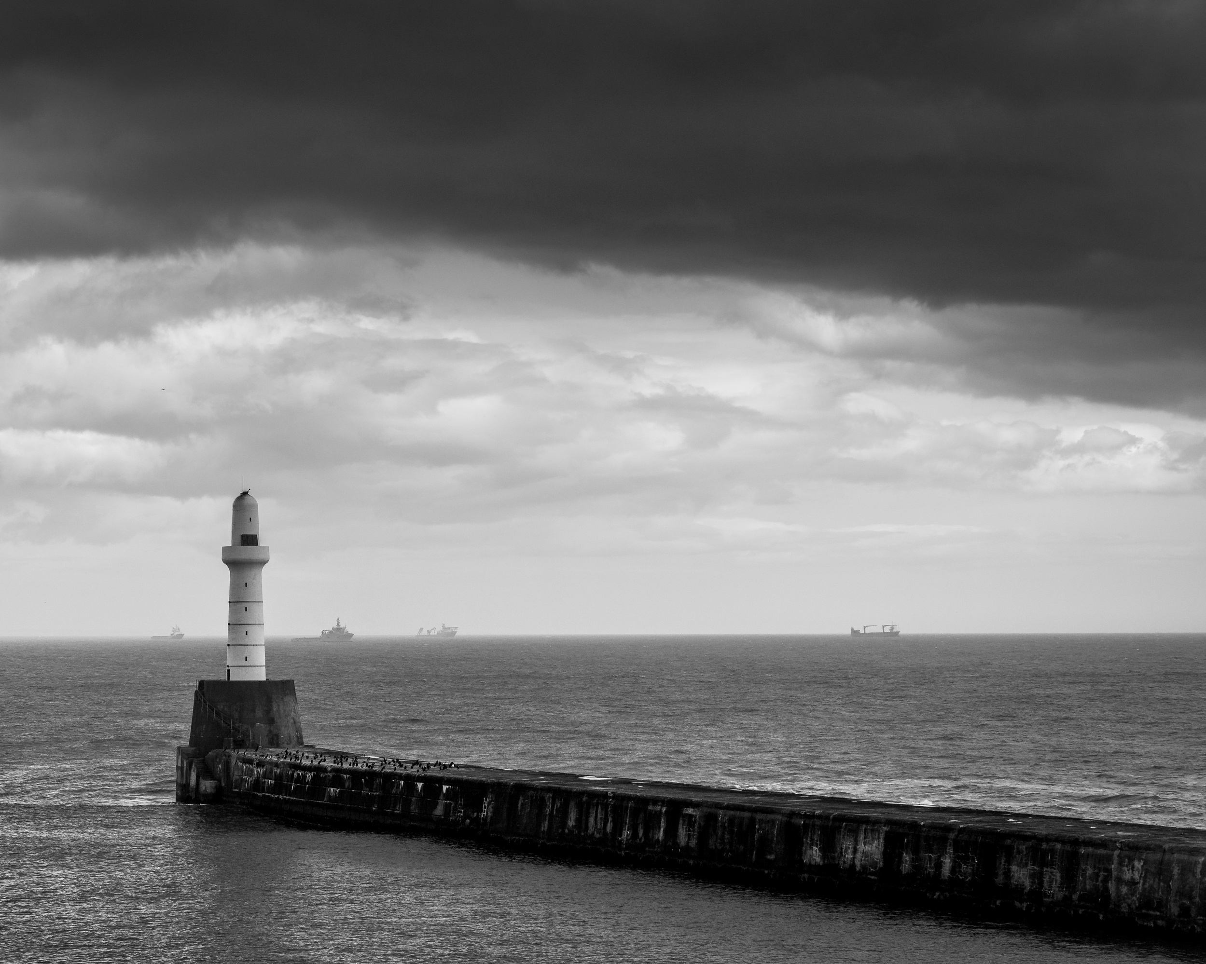
BREAKWATERS

Slide 15
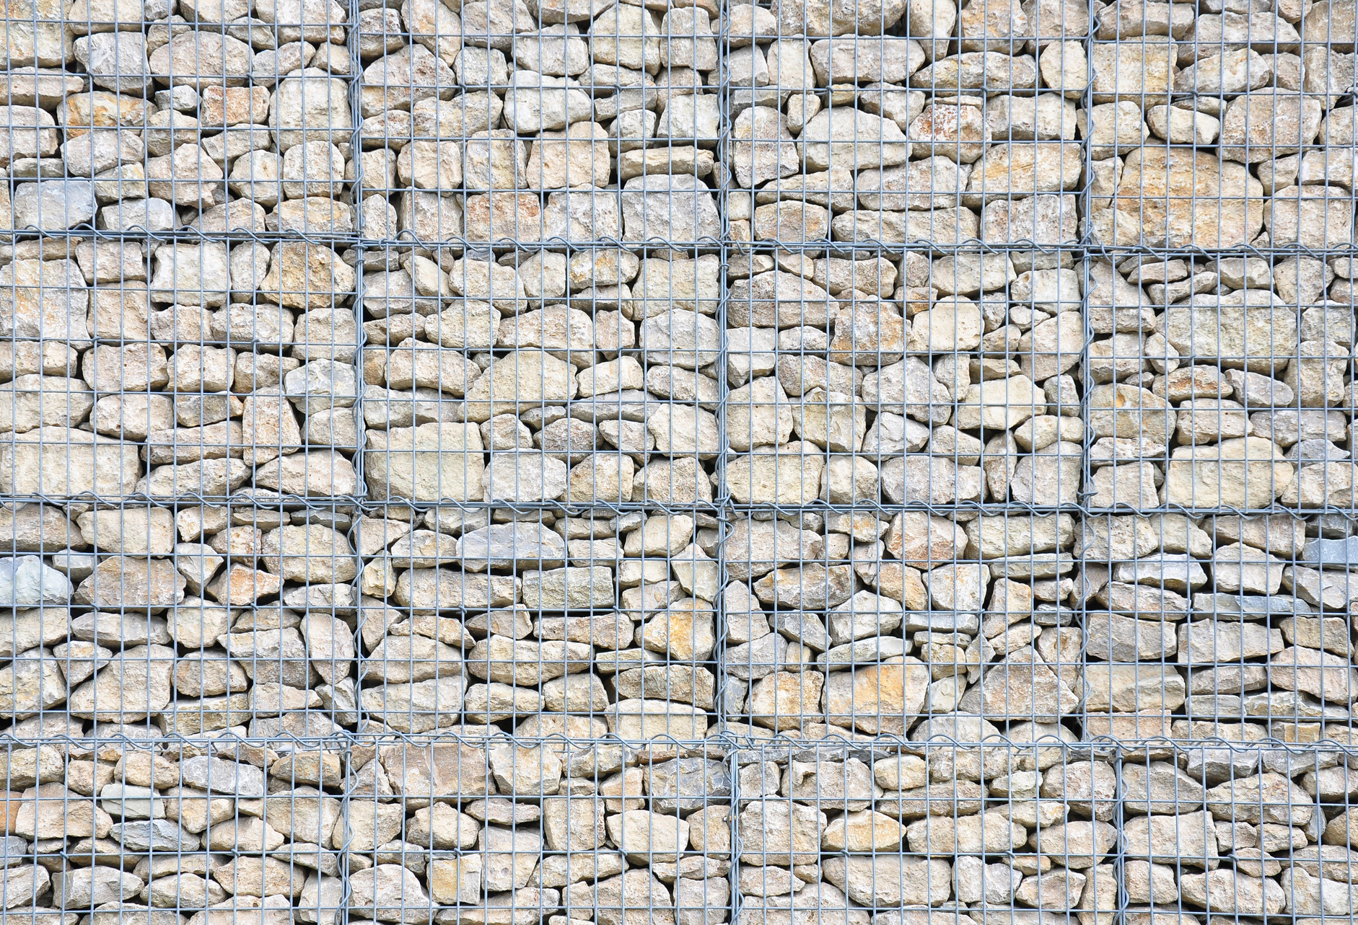
GABIONS

Slide 16
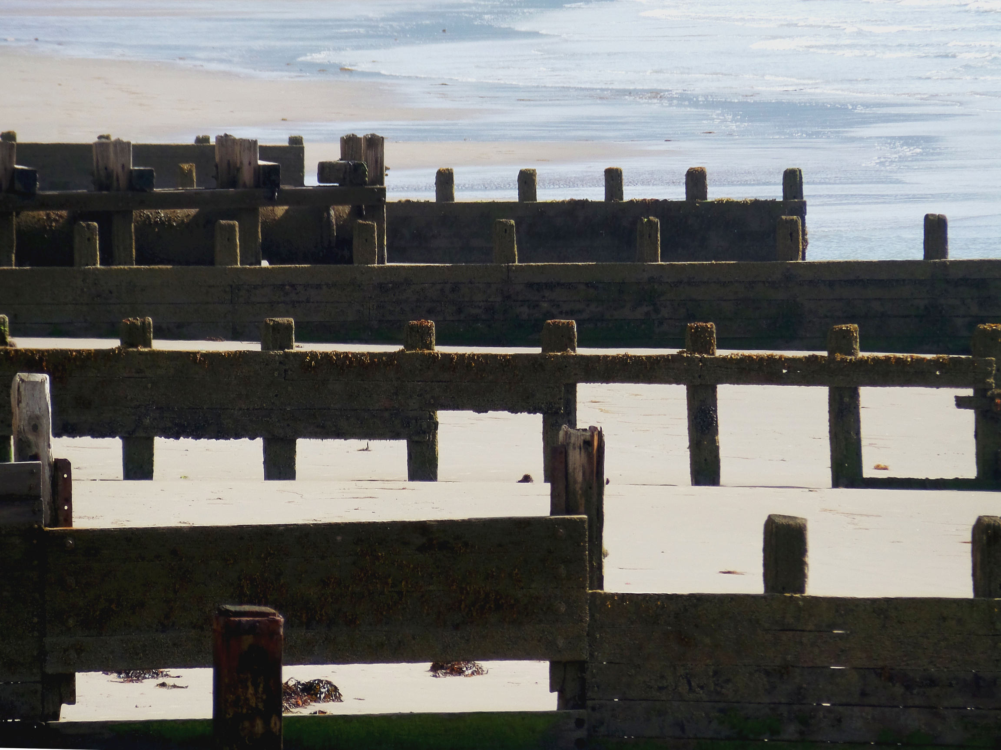
GROYNES

Slide 17
SOFT ENGINEERING
This includes natural defences, such as...

Slide 18
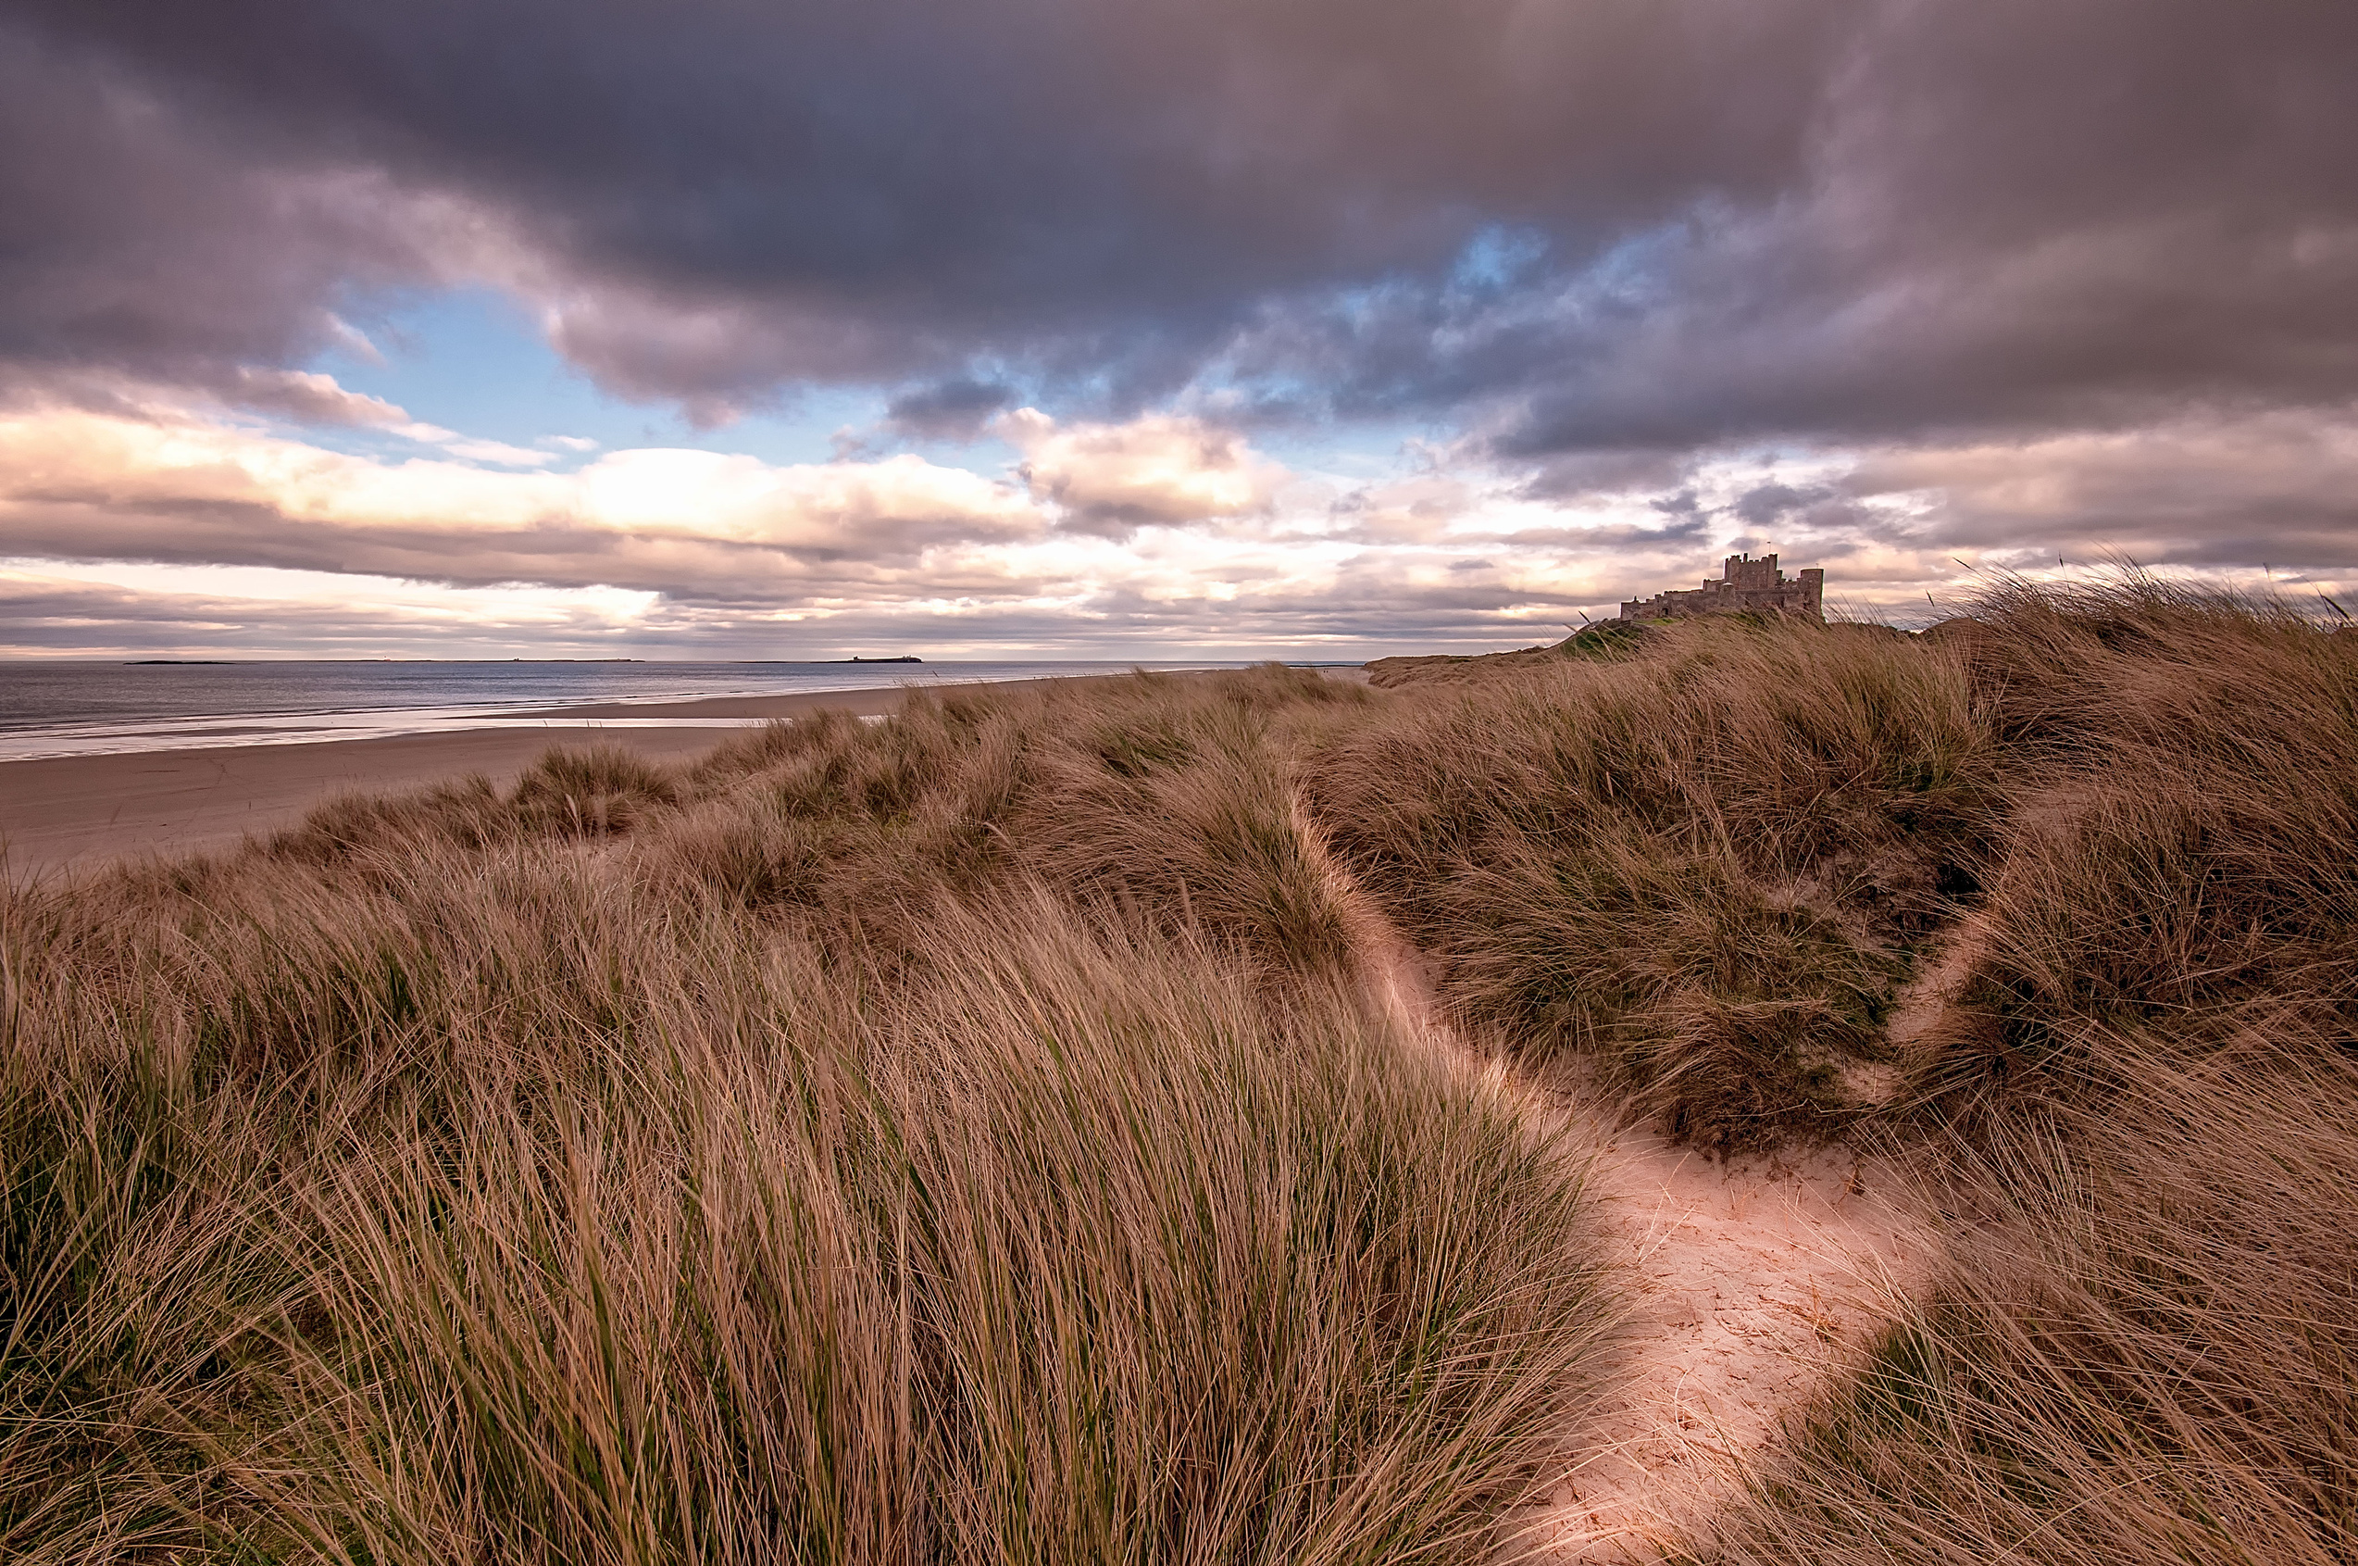
SAND DUNES

Slide 19
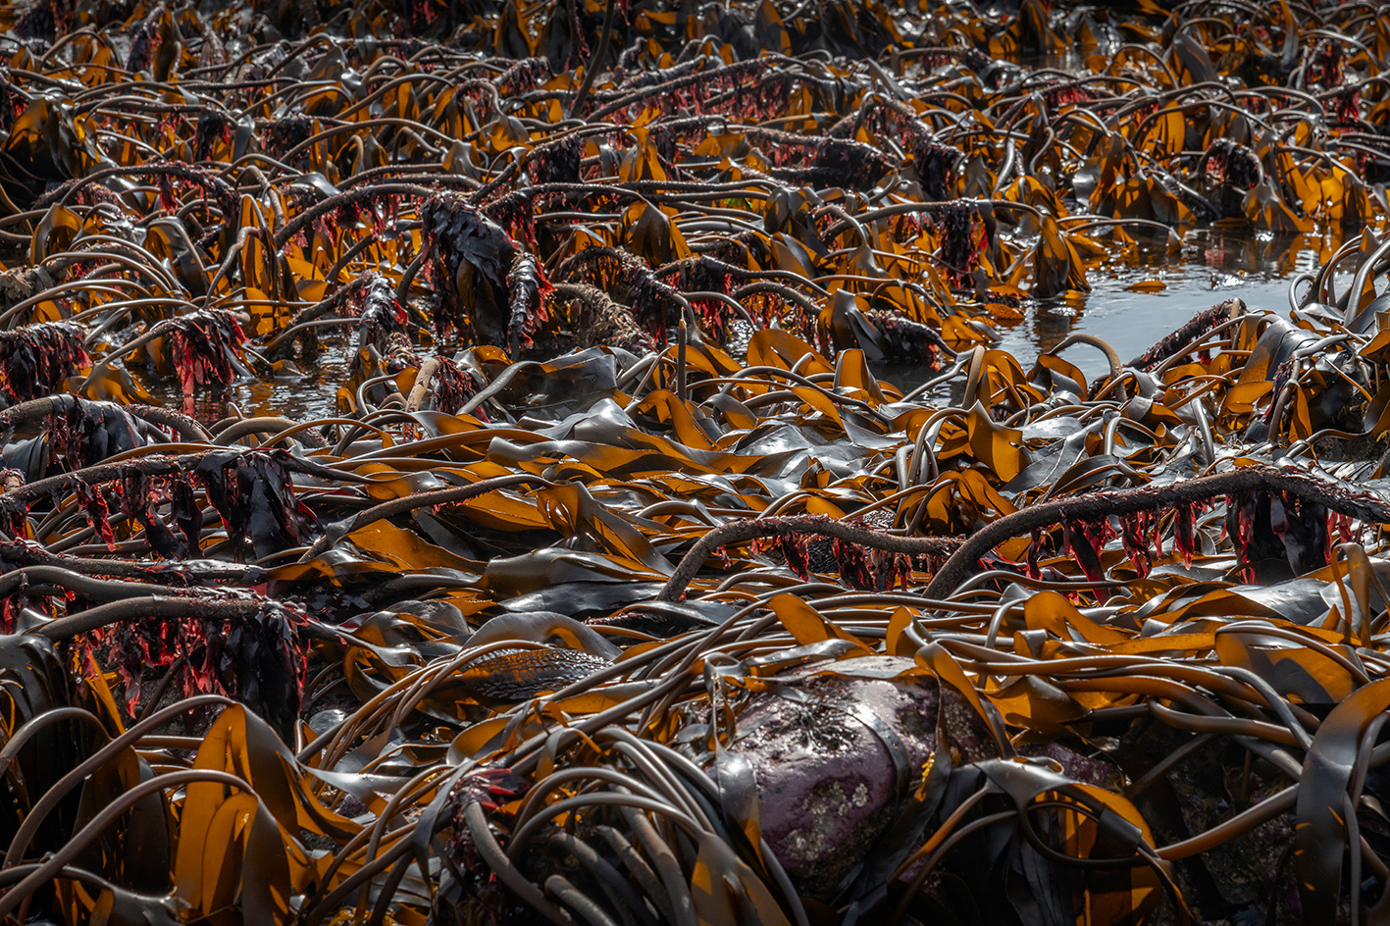
KELP FORESTS

Slide 20
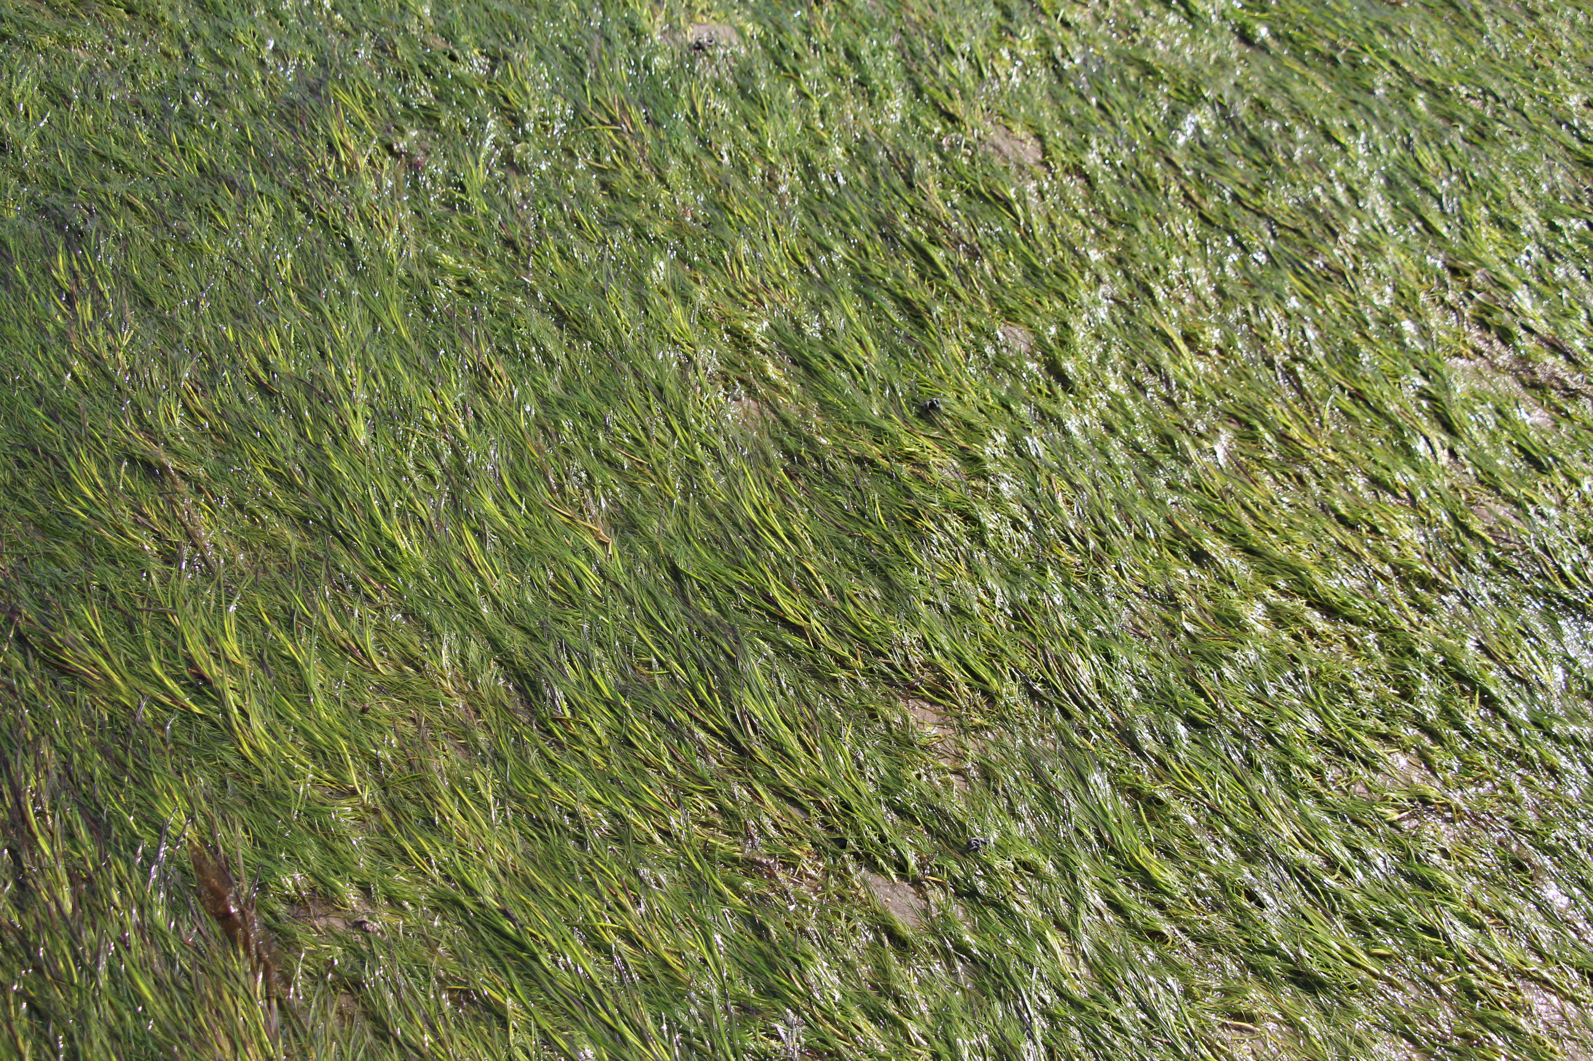
SEAGRASS MEADOWS

Slide 21
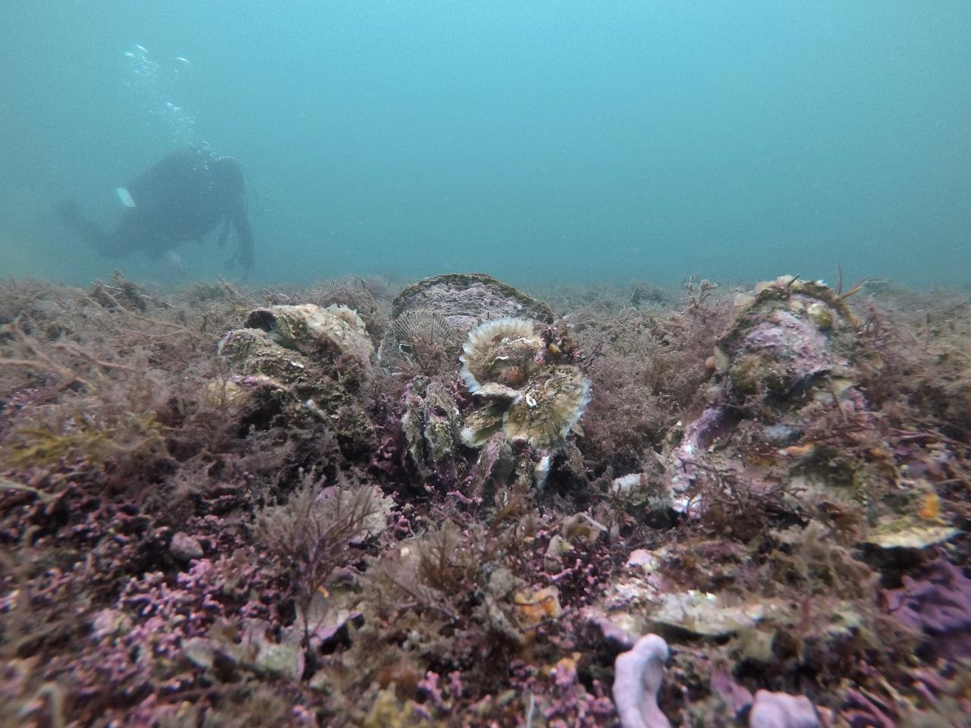
OYSTER REEFS
Pouvreau Stephane (2017). Underwater images of the last native oysters beds in Brittany (France). Ifremer. https://doi.org/10.24351/48842

Slide 22
PROS AND CONS
There are benefits and set backs to each of these approaches to protecting our coasts...
HARD ENGINEERING (PROS) | HARD ENGINEERING (CONS) | SOFT ENGINEERING (PROS) | SOFT ENGINEERING (CONS)
STRONG AND DURABLE | EXPENSIVE | BENEFITS NATURE | UNPREDICTABLE
PLACE THEM WHEREVER YOU LIKE | CAN BE CONSIDERED UGLY | CAN IMPROVE WATER QUALITY | TAKES A LONG TIME TO GROW A HABITAT THAT CAN PROTECT THE COAST
DESIGNED HOW YOU WANT THEM | ERODE OVER TIME | OFTEN HIDDEN FROM VIEW | NO GUARANTEE THE SPECIES WILL SURVIVE IN THE AREA

Slide 23
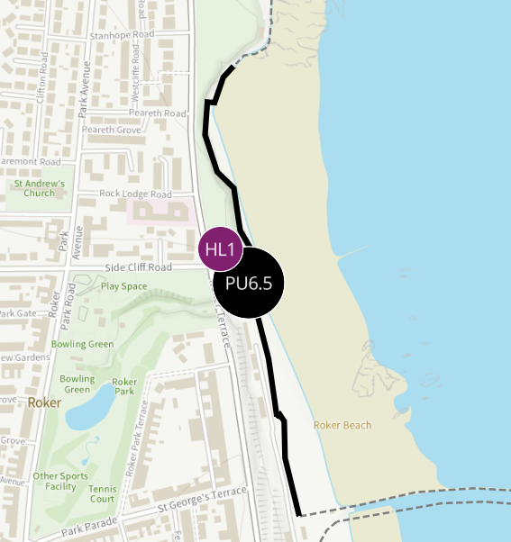
YOUR AREA
You can explore what the plans for defending your local coastline are here (https://environment.data.gov.uk/shoreline-planning).
There are 4 potential options:
Hold the line
Advance the line
Managed Realignment
No active intervention
DEFRA Shoreline Management Tool

Slide 24
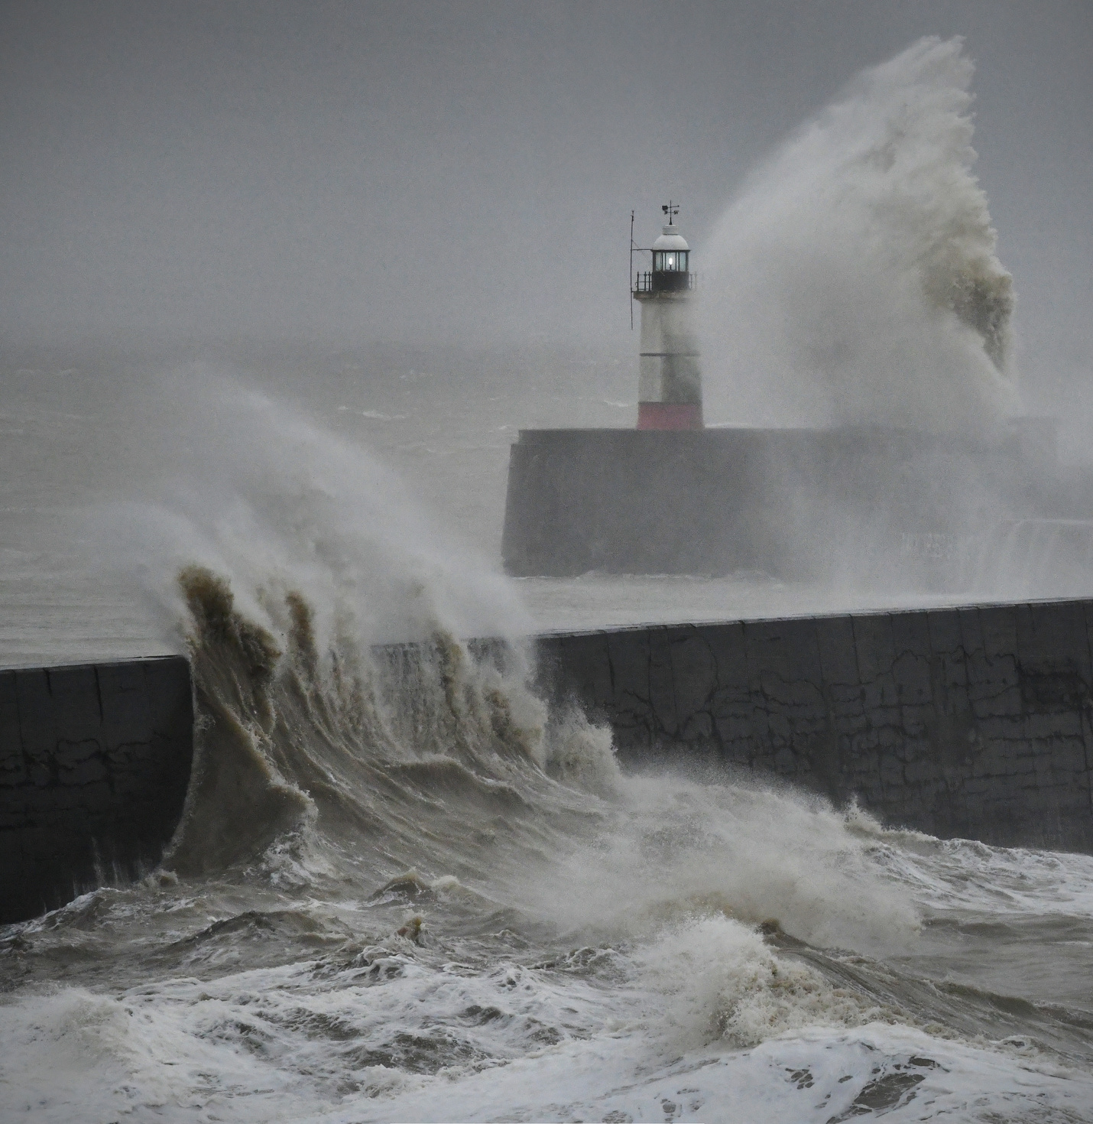
HOLD THE LINE
This means that plans are in place to protect this part of the coastline from erosion.

Slide 25
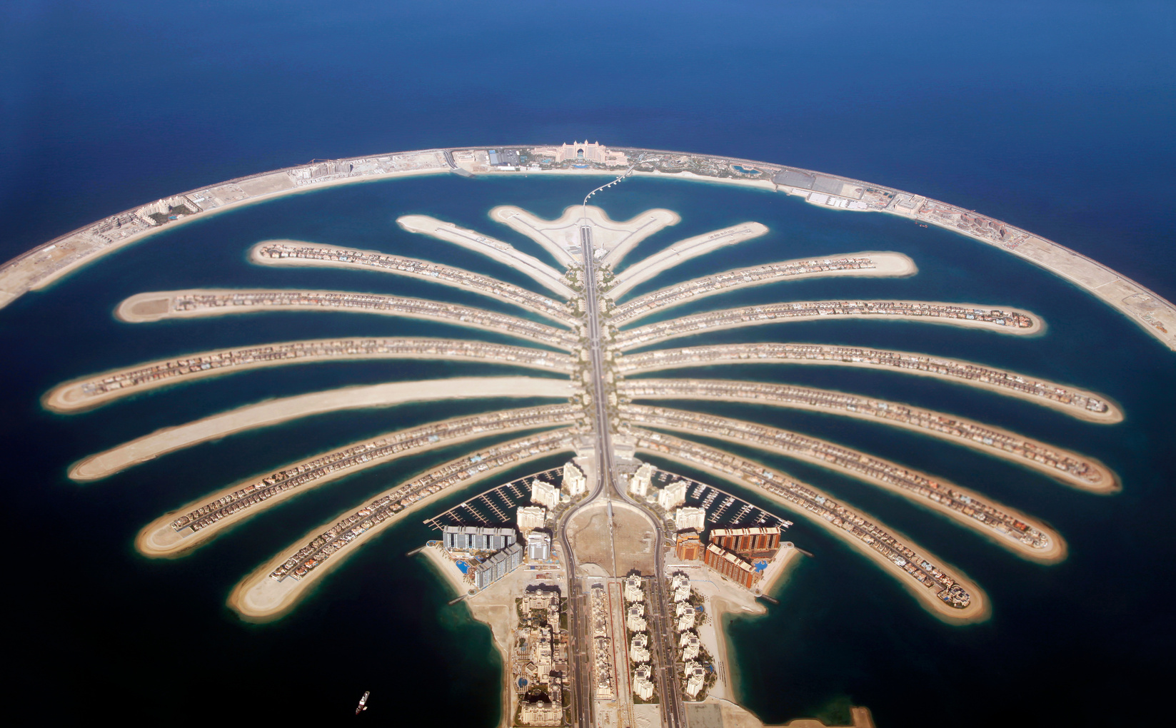
ADVANCE THE LINE
This means that plans are in place to build out into the water, extending the coastline.
Based in Dubai, the Palm Jumeirah is one of the world’s most famous land reclamation projects!

Slide 26
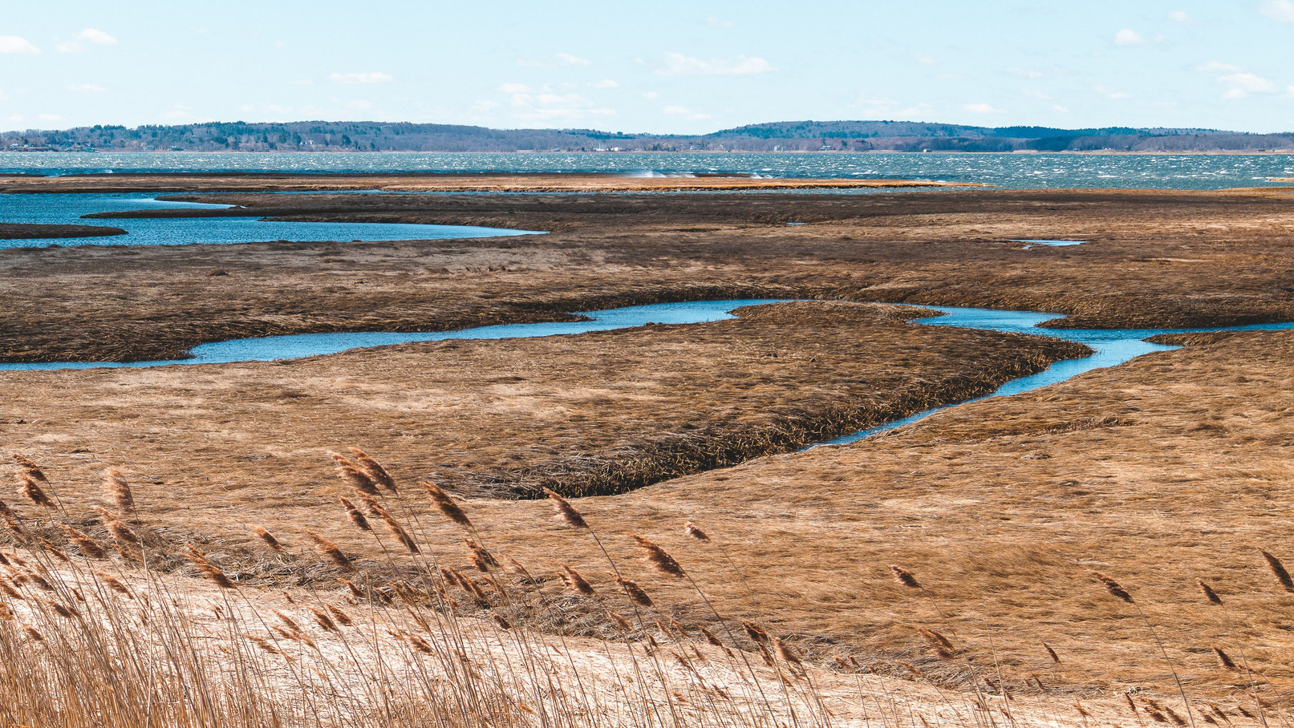
MANAGED REALIGNMENT
This means that plans are in place to allow erosion to take place, but in a controlled manner, limiting erosion to a degree.
Coastal flooding is allowed to take place to create natural wetlands

Slide 27
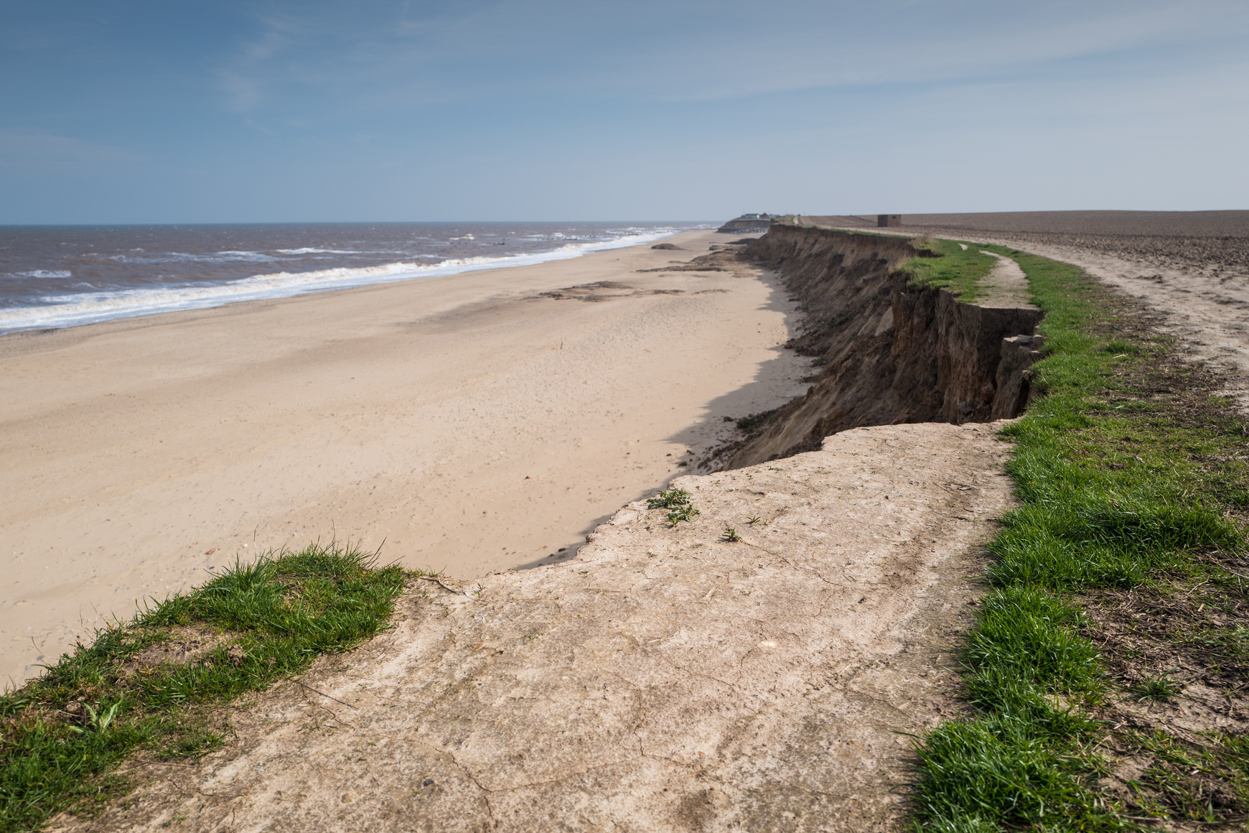
NO ACTIVE INTERVENTION
This means that erosion will be allowed to continue without any plans in place to protect the area.

Slide 28
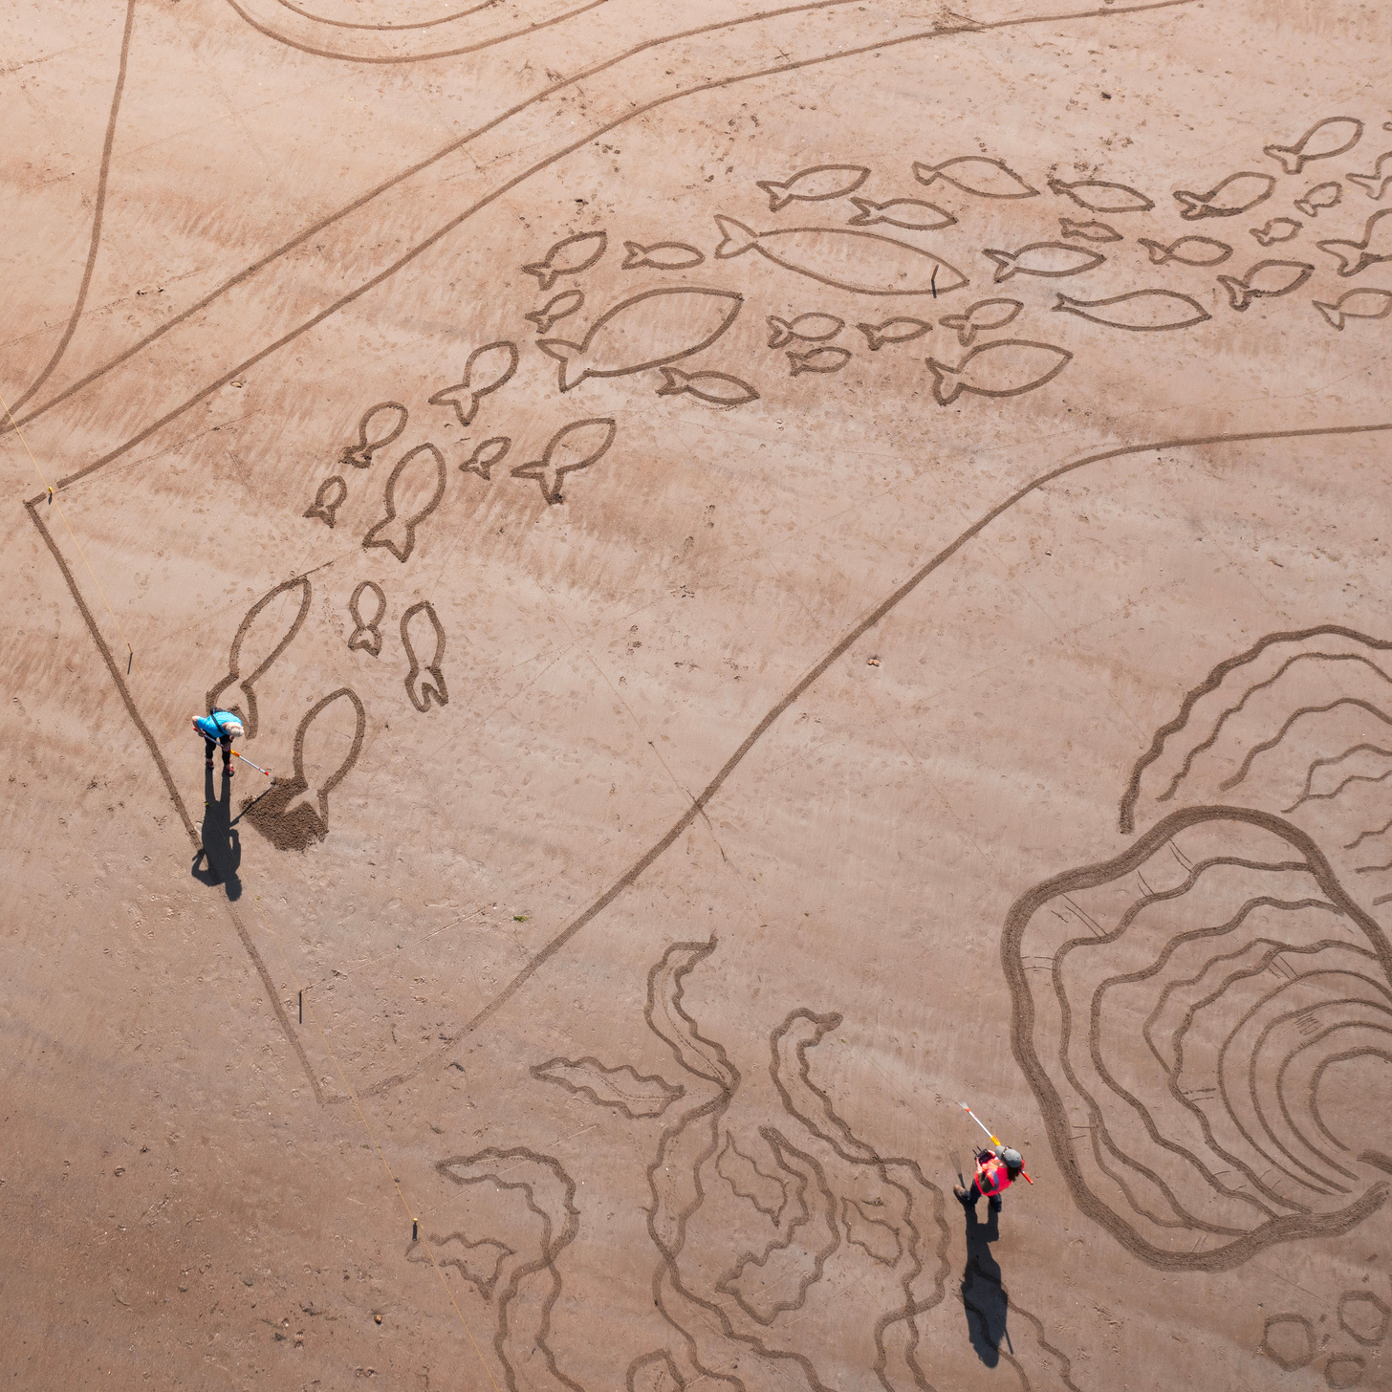
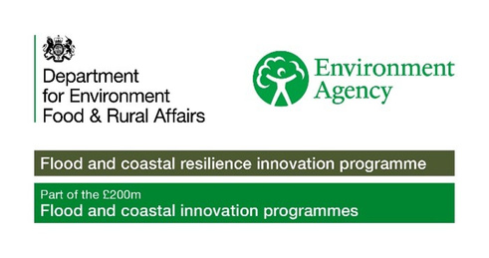

ACTIVITY TIME
In this section you can now complete the associated quiz, and can do the activity in the accompanying pdf!

